Slide 1
Data Models and Frameworks (Wk3-4)
Hants Williams, PhD, RN

Slide 2

Interesting things…
https://www2.deloitte.com/us/en/blog/health-care-blog/2023/outlook-for-health-equity.html
Women and the Glass Cliff?
https://www.oracle.com/news/announcement/oracle-appoints-seema-verma-to-lead-oracle-life-sciences-2023-04-20/
https://hbr.org/2011/01/how-women-end-up-on-the-glass-cliff
https://www.mckinsey.com/industries/healthcare/our-insights/women-in-healthcare-and-life-sciences-the-ongoing-stress-of-covid-19

Slide 3
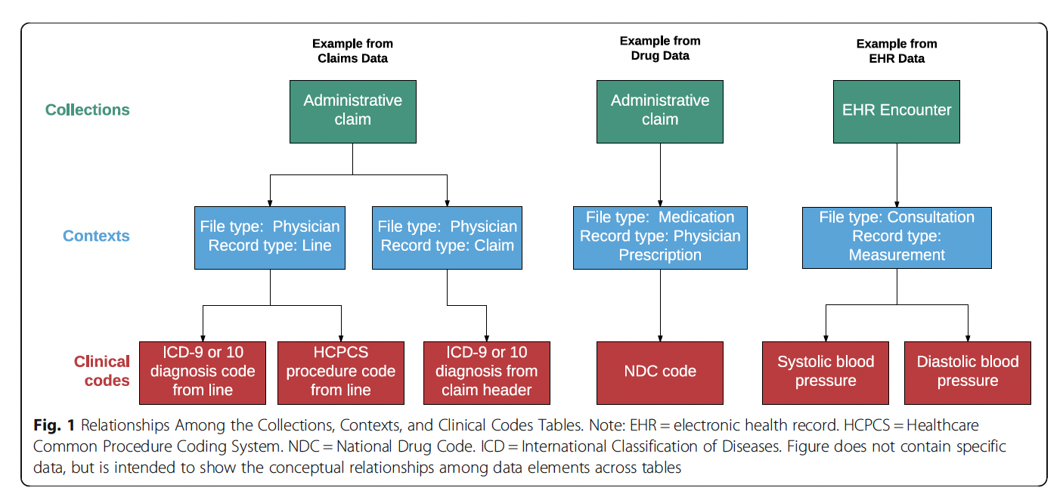
Main Sources of Health Data
Primary
EMR / EHR
PHRs
PBMs
RIS/LIS
RCMs
Secondary
HIE
Government (CMS, CDC)
Patient/disease registries
Clinical Trial registries

Slide 4
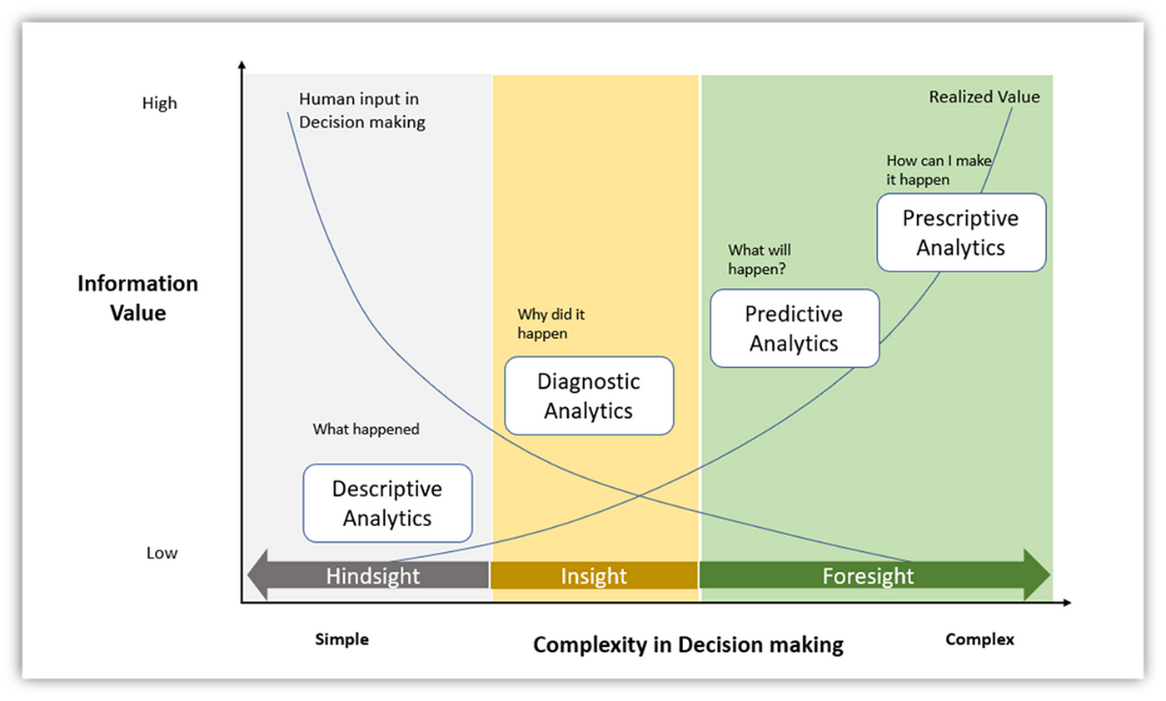
How we use data the data…types of HIS’ applications can be: descriptive to prescriptive
https://medium.com/@milind.bapuji.desai/understanding-the-analytics-maturity-model-84982836b107

Slide 5


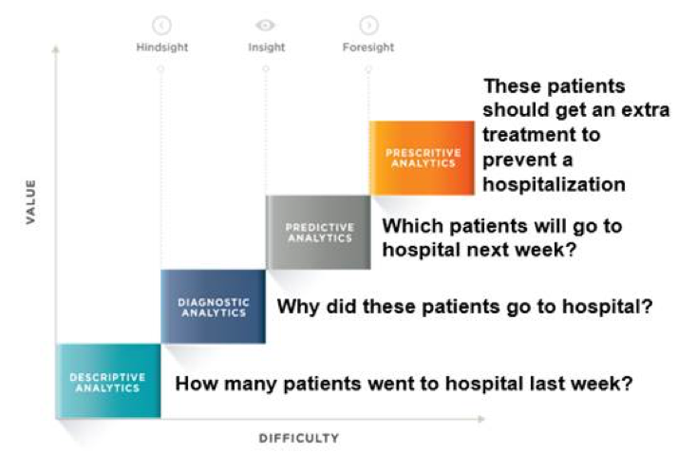
General VS AHA:
https://www.aha.org/center/market-insights/leveraging-data/maturity-framework-data-driven-health-care-organizations
https://www.aha.org/system/files/media/file/2021/01/MI_Leveraging_Data_Maturity_Framework.pdf

Slide 6
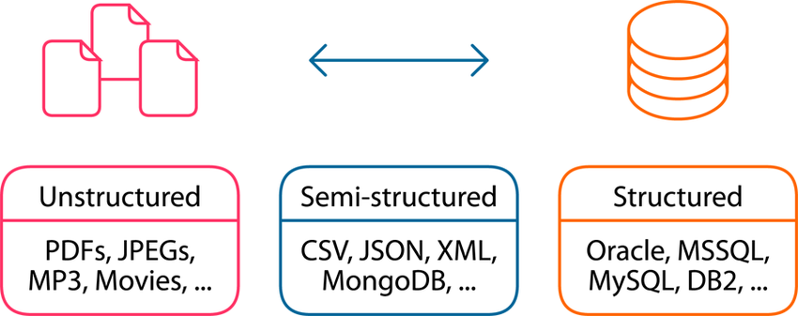
Structured, Unstructured, Semi
https://www.researchgate.net/figure/Different-data-types-structured-semi-structured-and-unstructured-Structured-data-is_fig4_368672613

Slide 7
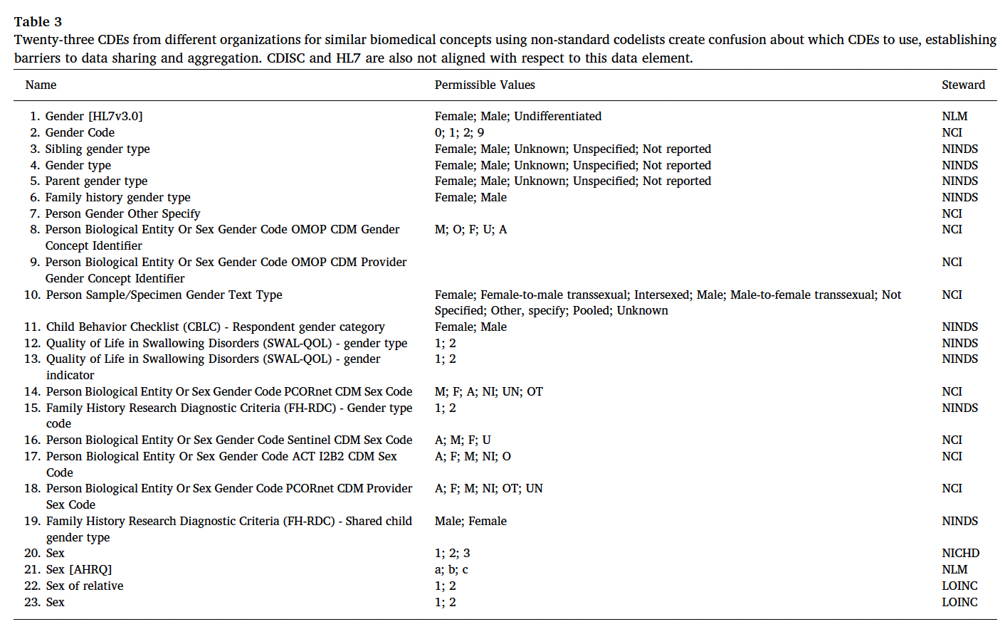
Many versions of the same thing…Gender as an example:

Slide 8
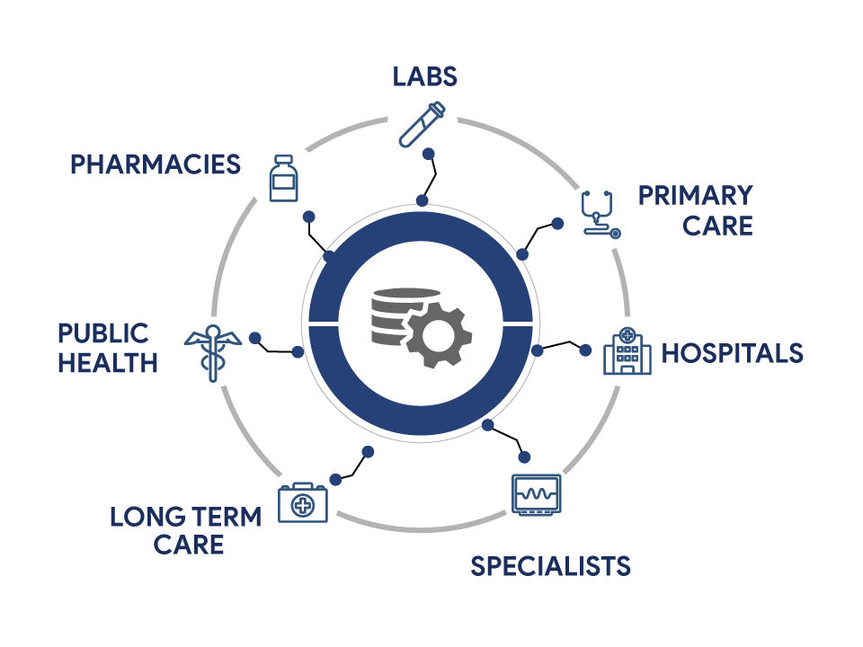
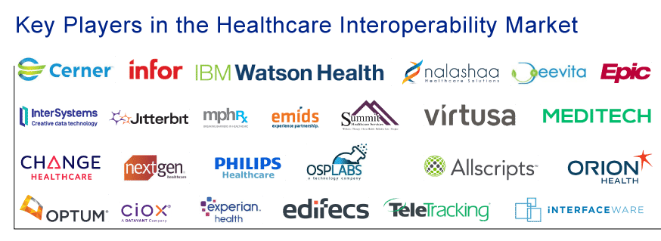
Solving interoperability
HITECH -> 21st Century Cures
https://www.cms.gov/newsroom/press-releases/cms-finalizes-rule-expand-access-health-information-and-improve-prior-authorization-process
https://www.healthit.gov/topic/laws-regulation-and-policy/health-it-legislation
https://jelvix.com/blog/interoperability-in-healthcare
https://www.delveinsight.com/blog/interoperability-solutions-in-healthcare
Notes:
https://jelvix.com/blog/interoperability-in-healthcare

Slide 9
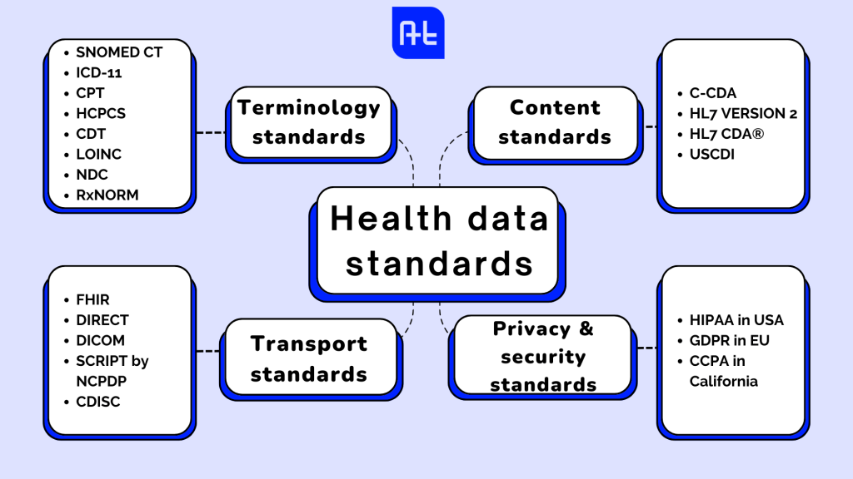
Solving with Data Standards…
In addition, we have the following content formats:
DICOM – imaging
Great resource below to find standards:
https://www.healthit.gov/isa/isa-document-table-contents
https://allhealthtech.com/health-data-standards/

Slide 10

Organizing Chaos: Federal Level
https://hips.hearstapps.com/hmg-prod/images/design-elements-royalty-free-image-1663878957.jpg
NIH -> CDEs -> Common Data Elements
Office of the National Coordinator ( https://healthit.gov ) :
United States Core Data for Interoperability (USCDI)
https://www.healthit.gov/isa/united-states-core-data-interoperability-uscdi#draft-uscdi-v5

Slide 11
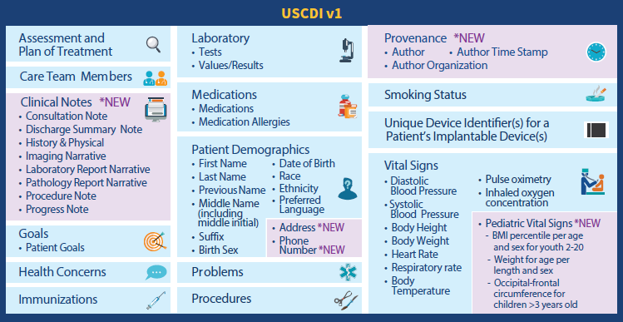
USCDI v1

Slide 12
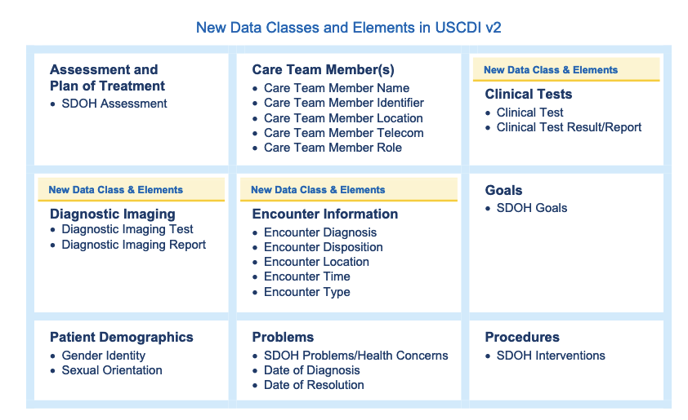
USCDI v2
https://www.particlehealth.com/blog/uscdi-changelog

Slide 13
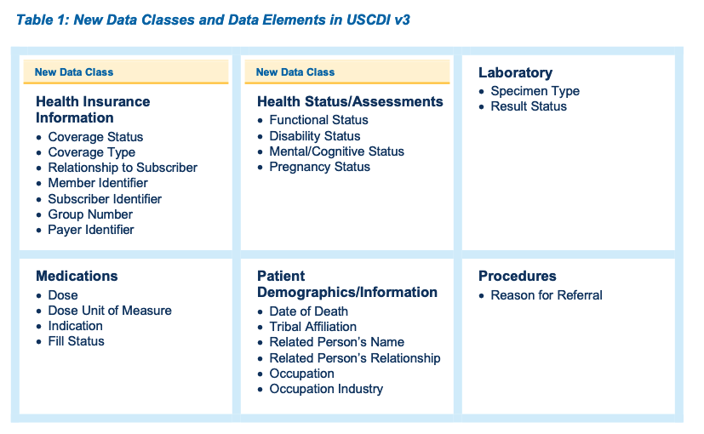
USCDI v3
https://www.particlehealth.com/blog/uscdi-changelog

Slide 14
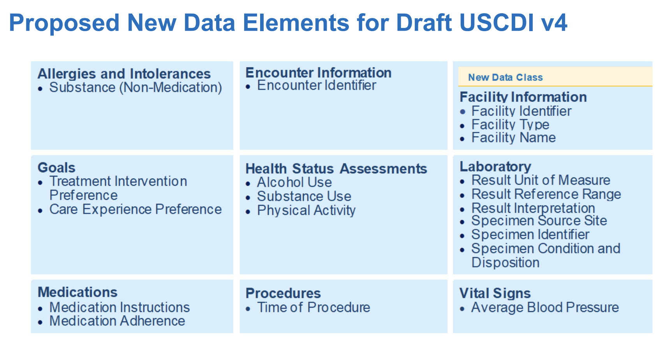
USCDI v4
https://www.healthit.gov/sites/default/files/facas/2023-01-19_Overview_of_Draft_USCDI_Version_4_HITAC_Presentation_508.pdf

Slide 15
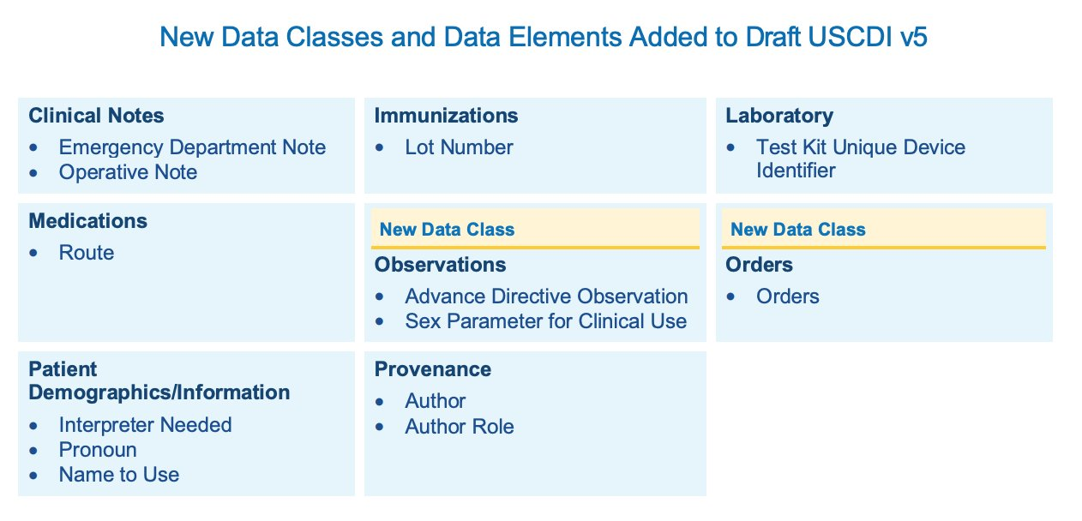
USCDI v5 Draft

Slide 16
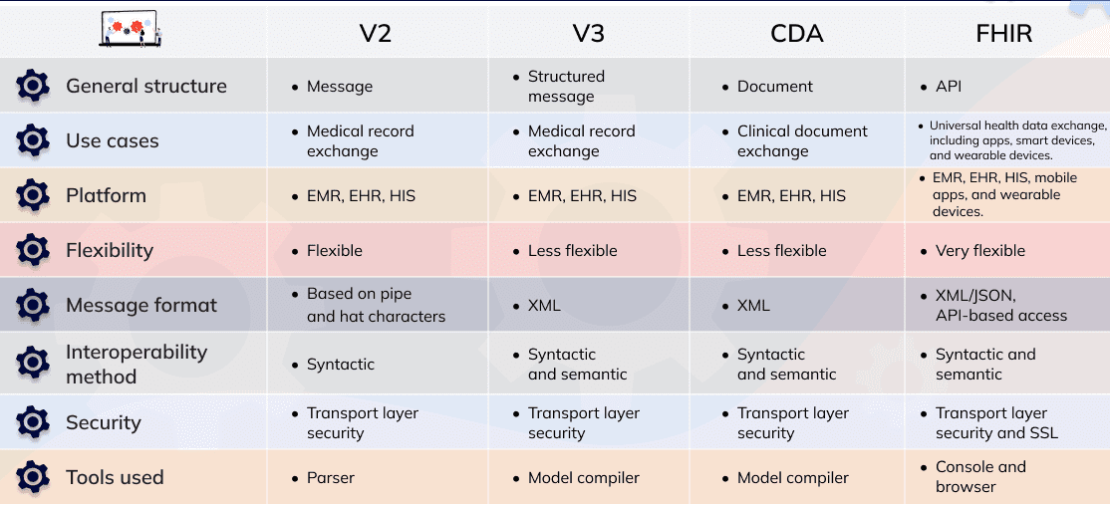
HL7 v2 (89) --> CDA (96-05) --> FHIR (12-Pres)
https://medium.com/@IntelliSoft/comparing-hl7-vs-fhir-core-differences-1b14cb001fef

Slide 17
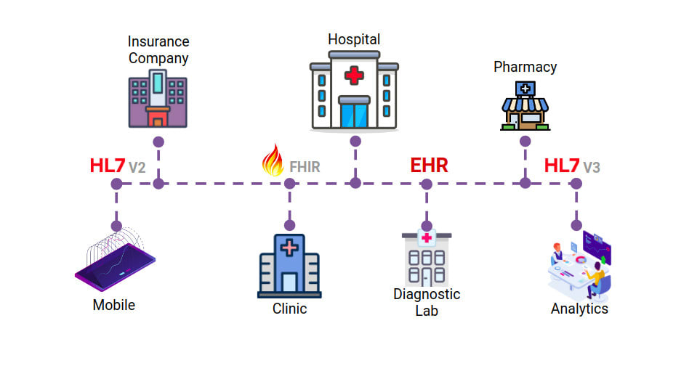
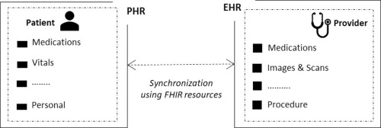
FHIR examples: patient/admin specific:
https://build.fhir.org/
Patient:
https://build.fhir.org/patient.html
https://build.fhir.org/patient-example.json

Slide 18
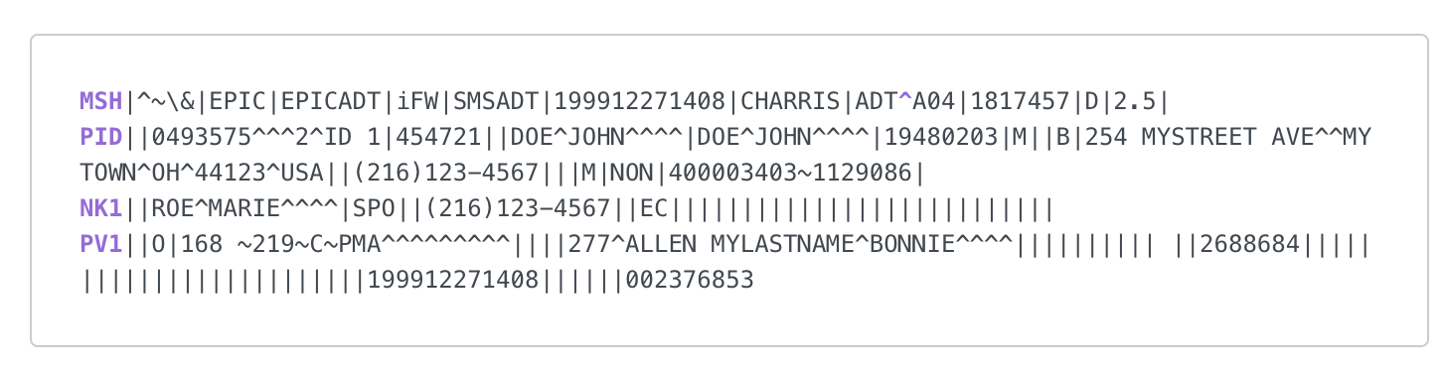
HL7-v3
The MSH (Message Header) segment contains information about the message itself. This information includes the sender and receiver of the message, the type of message this is, and the date and time it was sent. Every HL7 message specifies MSH as its first segment.
The PID (Patient Information) segment contains demographic information about the patient, such as name, patient ID and address.
The NK1 (Next of Kin) segment contains contact information for the patient’s next of kin.
The PV1 (Patient Visit) segment contains information about the patient’s hospital stay, such as the assigned location and the referring doctor.
https://www.interfaceware.com/hl7-message-structure

Slide 19
Code Sets

Slide 20
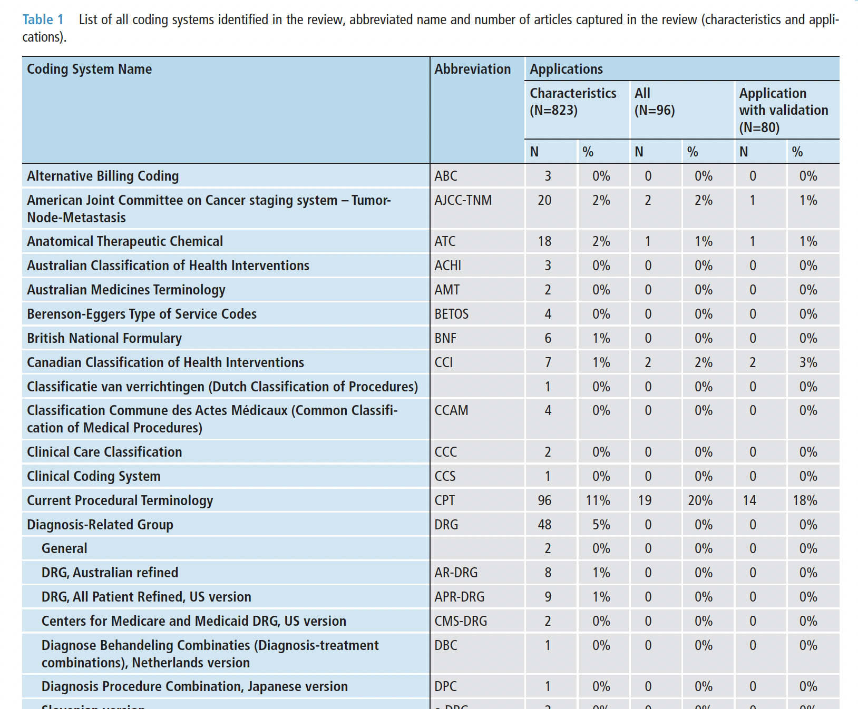
Review article // at least ++ 57 coding systems identified in 2018

Slide 21
Primary Code Sets
ICD variations
CPT
HCPCS
SnowMed
DRGs
NDC
RxNorm
LOINC
NPI

Slide 22
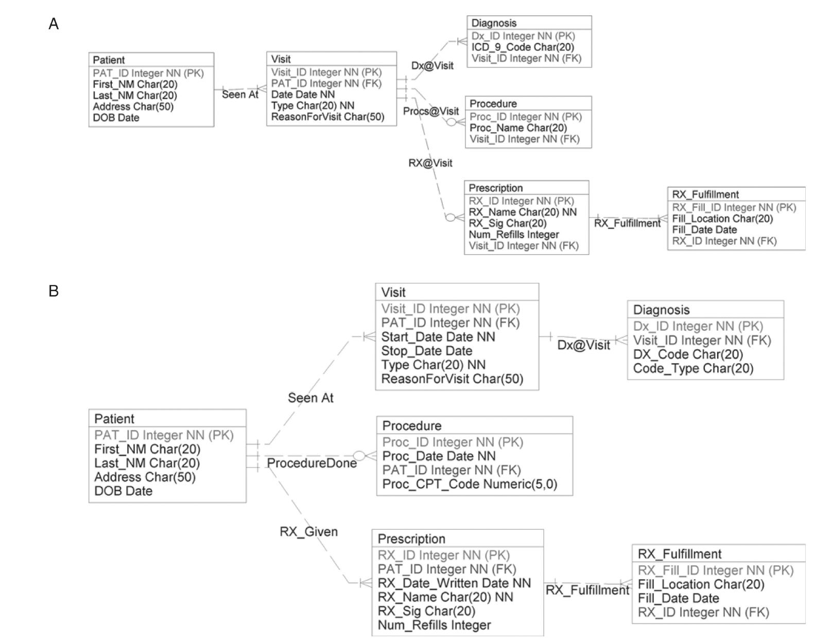

Slide 23
ICD ?

Slide 24
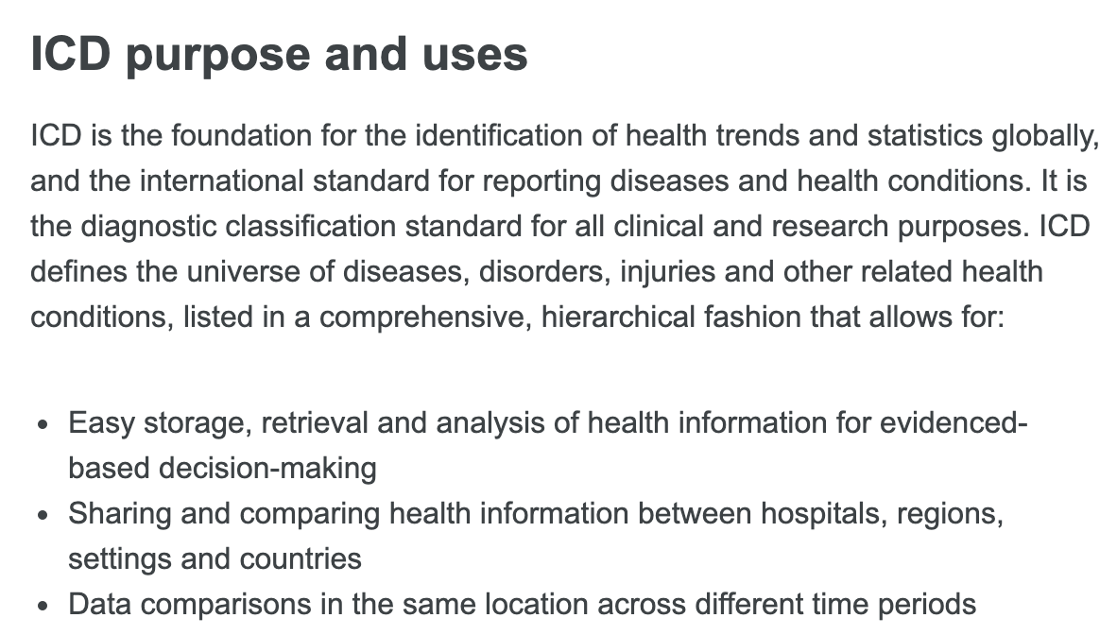
International Classification of Diseases (ICD)
https://www.who.int/standards/classifications/classification-of-diseases

Slide 25
ICD-9 CM/PCS versus ICD9
ICD-10 CM/PCS versus ICD10
ICD-11 CM/PCS versus ICD11
ICD-9-CM
ICD-9-PCS
ICD-10-CM
ICD-10-PCS

Slide 26
ICD-{X} versus ICD-{X} CM/PCS

Slide 27
ICD-10/11 WHO
https://icd.who.int/browse10/2019/en
https://www.health.gov.za/icd-10-master-industry-table/

Slide 28
The ICD-10-CM (International Classification of Diseases, Tenth Revision, Clinical Modification) is a system used by physicians and other healthcare providers to classify and code all diagnoses, symptoms and procedures recorded in conjunction with hospital care in the United States. It provides a level of detail that is necessary for diagnostic specificity and morbidity classification in the U.S
Developed by the Centers for Medicare and Medicaid Services (CMS)
Importance of ICD-10-CM codes
ICD-10-CM codes are important because they are more granular than ICD-10 codes and can provide more information about the severity of a patient's condition.
https://www.cms.gov/medicare/coding/icd10

Slide 29
ICD-10-CM

Slide 30
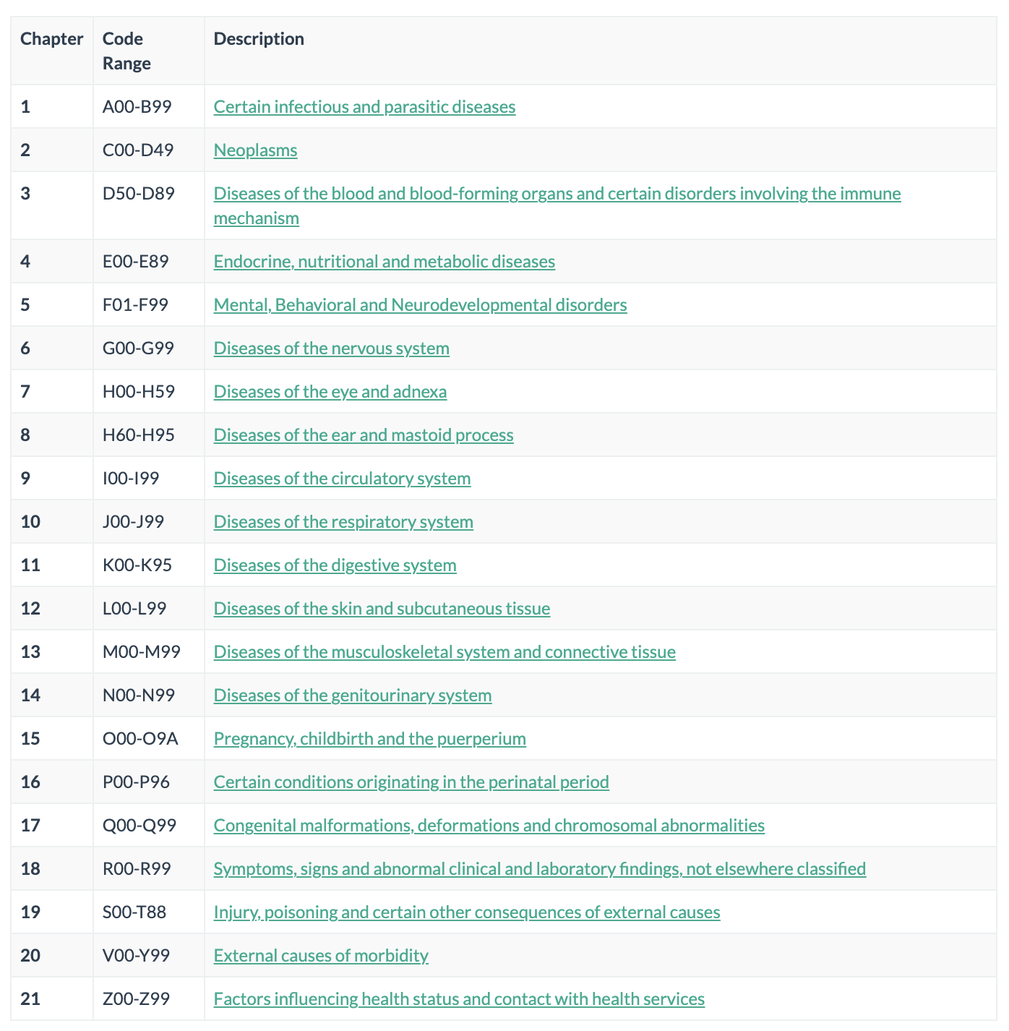
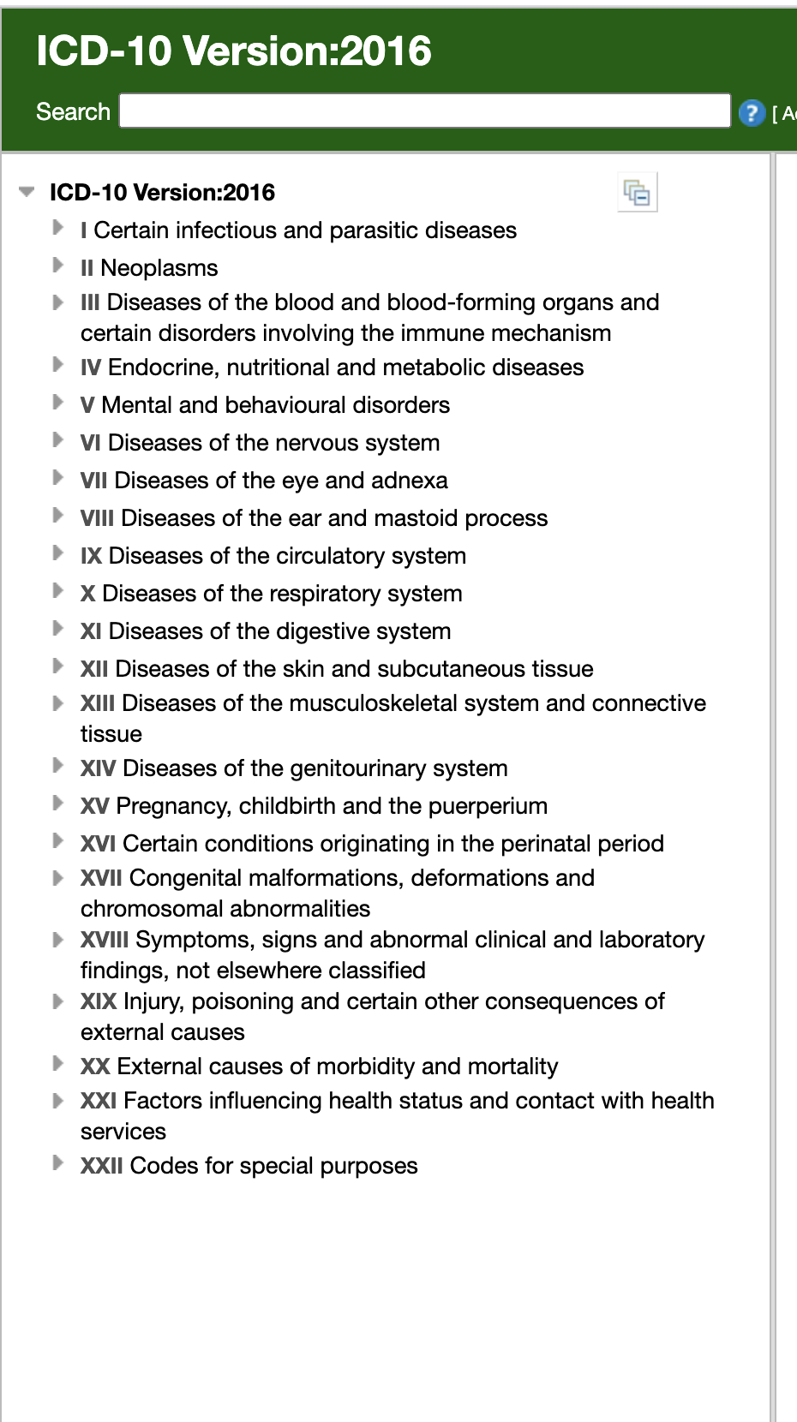
https://icd.codes/icd10cm

Slide 31
https://www.policymed.com/2014/10/icd-10-hhs-officially-delays-compliance-deadline-to-october-1-2015-stakeholders-advise-doctors-to-us.html

Slide 32
https://www.americanmedicalcoding.com/new-z-codes-icd-10-v-codes-icd-9/

Slide 33
ICD - CMS
https://www.cms.gov/Medicare/Coding/ICD10/2019-ICD-10-CM
Updated codes sets may be obtained free of charge at the following websites:
2022 ICD-10-CM: /Medicare/Coding/ICD10/2022-ICD-10-CM
2022 ICD-10-PCS: /Medicare/Coding/ICD10/2022-ICD-10-PCS

Slide 34
ICD-{X} CM versus ICD-{X} PCS

Slide 35
The ICD-10-PCS (International Classification of Diseases, Tenth Revision, Procedure Coding System) is a system used by physicians and other healthcare providers to assign codes to procedures associated with hospital utilization in the United States. ICD-10-PCS codes will support data collection, payment and electronic health records
Developed by the Centers for Medicare and Medicaid Services (CMS)
https://www.cms.gov/medicare/coding/icd10

Slide 36
ICD-10-PCS
https://www.hiacode.com/education/coding-tip-sneak-peek-at-fy2022-icd-10-pcs-procedure-additions-and-changes/

Slide 38
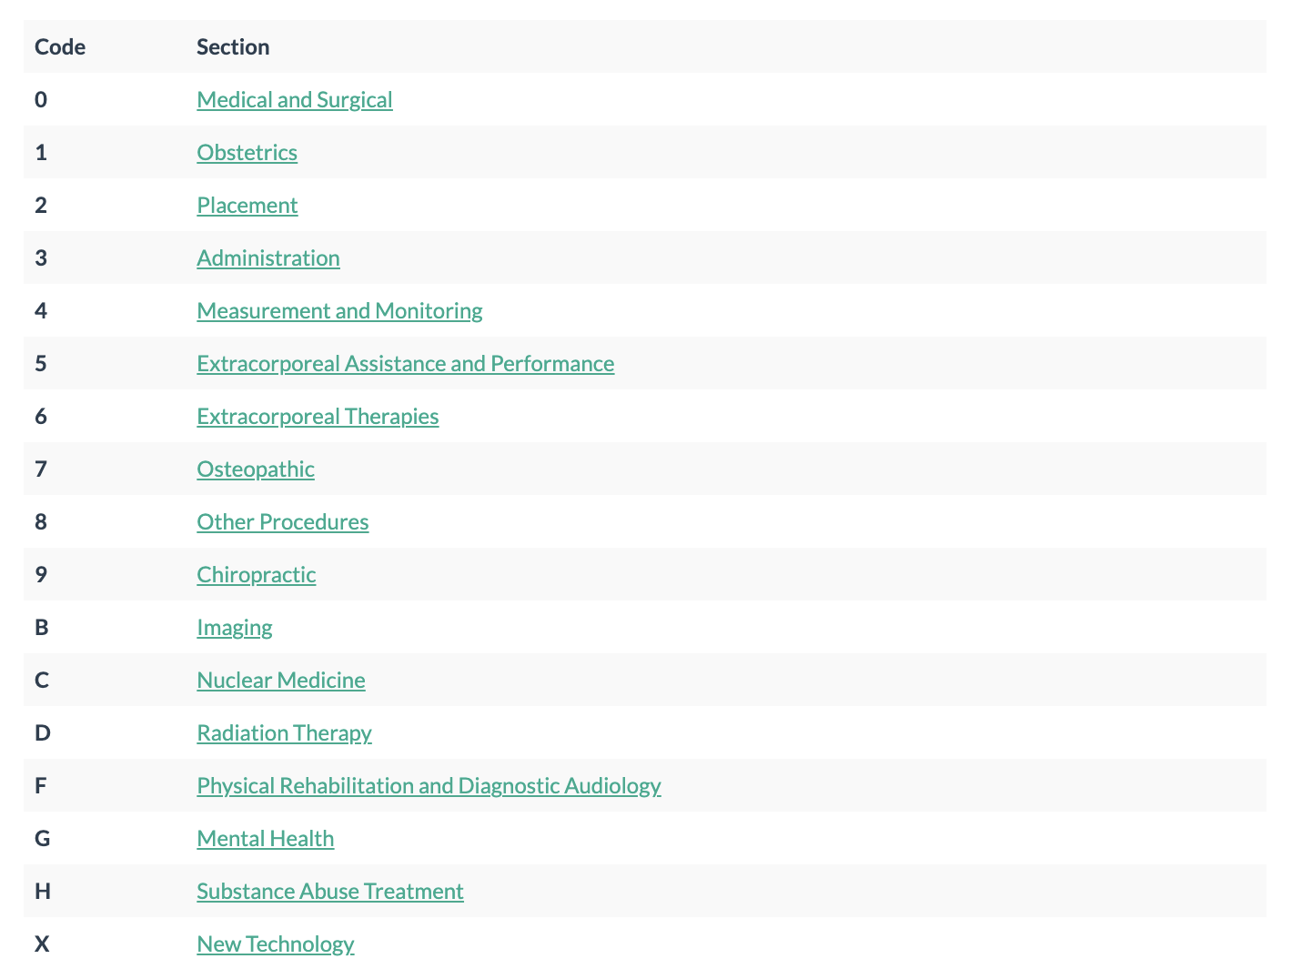
https://icd.codes/icd10p cs

Slide 39
Updated codes sets may be obtained free of charge at the following websites:
2022 ICD-10-PCS: https://www.cms.gov/Medicare/Coding/ICD10

Slide 40
CPT versus HCPCS

Slide 41
CPT {Current Procedural Terminology; AMA}
versus
HCPCS {Healthcare Common Procedural Coding System)

Slide 42
CPT is a code set to describe medical, surgical ,and diagnostic services; HCPCS are codes based on the CPT to provide standardized coding when healthcare is delivered.
CPT is largely private, as the AMA has copyright ownership and does not wish to give the codes freely; according the Health Insurance Portability and Accountability Act of 1996, everyone must have access to HCPCS codes.

Slide 43
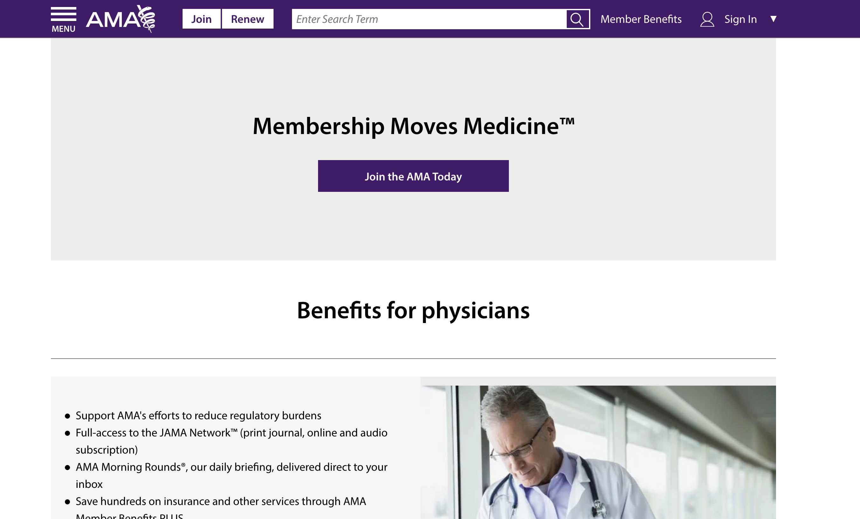
….the AMA receives upwards of $70 million per anum from these fees alone
Read more: Difference Between HCPCS and CPT | Difference Between http://www.differencebetween.net/science/health/difference-between-hcpcs-and-cpt/#ixzz76XfXVRLa

Slide 44
CPT codes
AMA
https://www.ama-assn.org/practice-management/cpt
Evaluation & Management Services (99202 – 99499)
Anesthesia Services (01000 – 01999)
Surgery (10021 – 69990) – further broken into body area or system within this code range
Radiology Services (70010 – 79999)
Pathology and Laboratory Services (80047 – 89398)
Medical Services and Procedures (90281 – 99607)

Slide 45
CPT / HCPCS
Level 1: CPT - AMA’s CPT codes and are numeric (mostly physician related – e.g., AMA);
Level 2: HCPCS (also known as modifiers) - (pronounced “hick-picks”) - alphanumeric codes that include non-physician products, supplies, and procedures not included in CPT (for instance, ambulance services and prosthetic devices)
Level 3: HCPCS - (also known as local codes) were developed by the state Medicaid agencies, Medicare contractors, and private insurers to be used in specific jurisdictions for specific programs. These are still included in the HCPCS reference coding book. Some payers prefer that coders report the Level III codes in addition to the Level I and Level II code sets. However, these codes are not nationally recognized

Slide 46
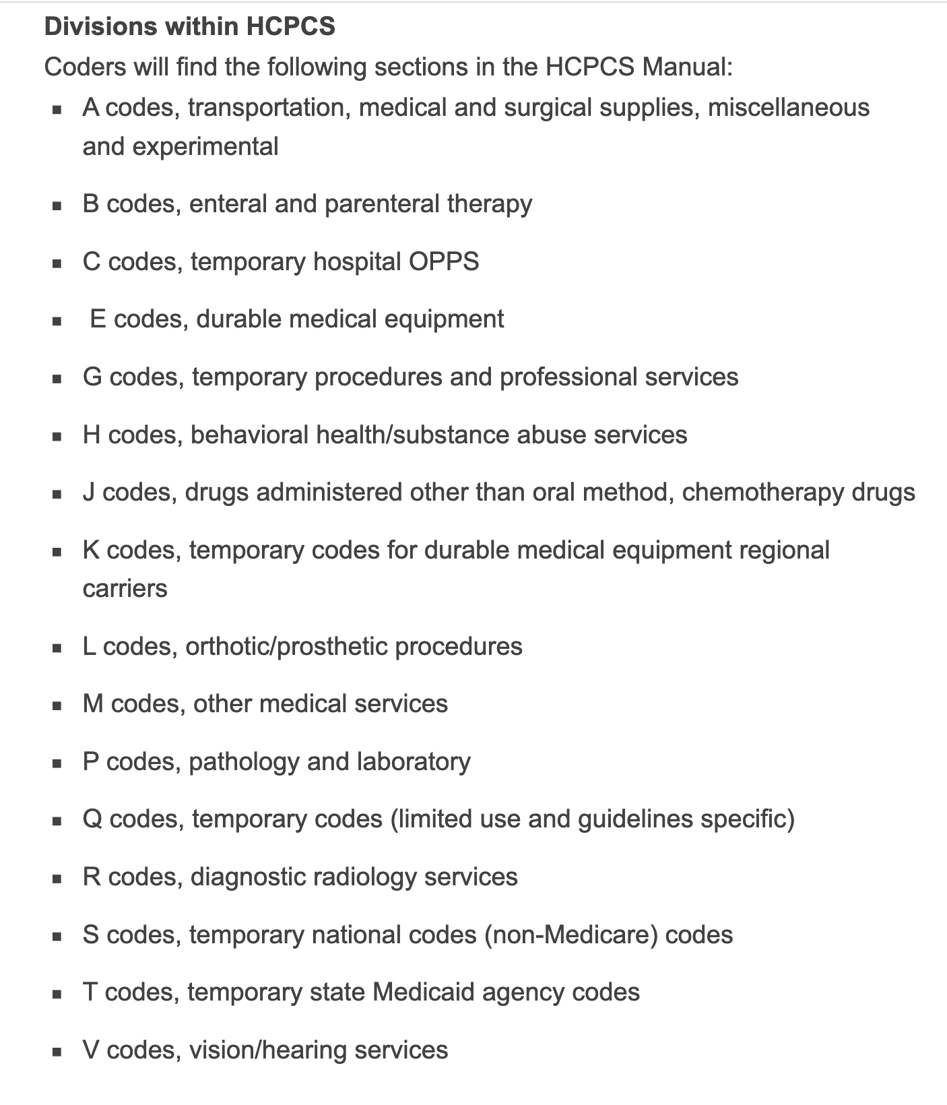

Slide 47
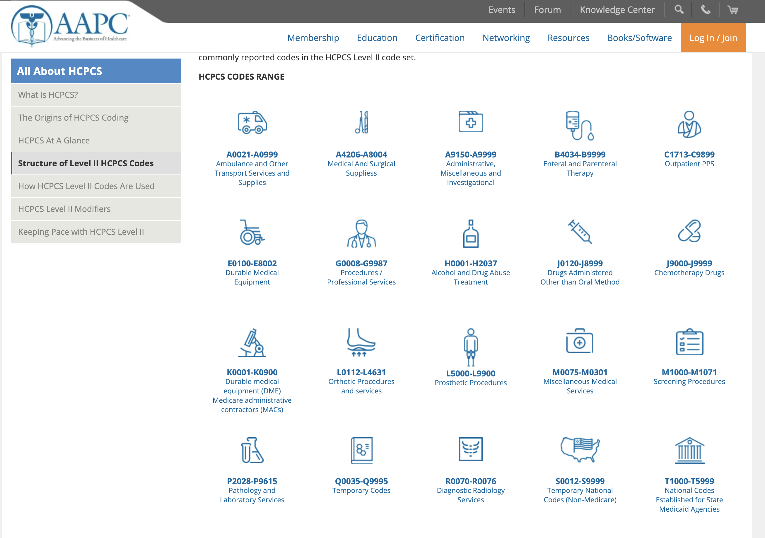
https://www.aapc.com/resources/medical-coding/hcpcs.aspx

Slide 48
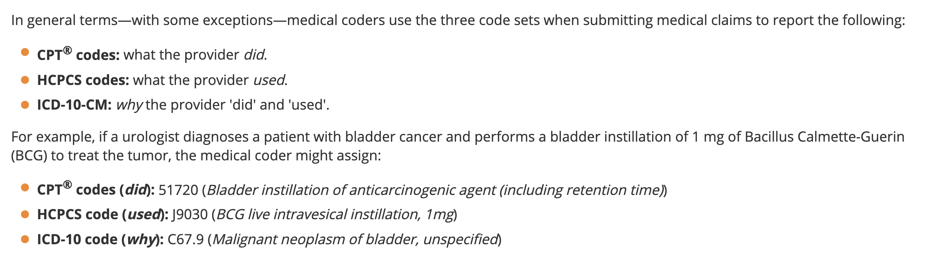
ICD / CPT / HCPCS
https://www.aapc.com/resources/medical-coding/hcpcs.aspx

Slide 49
snowMed-CT

Slide 50
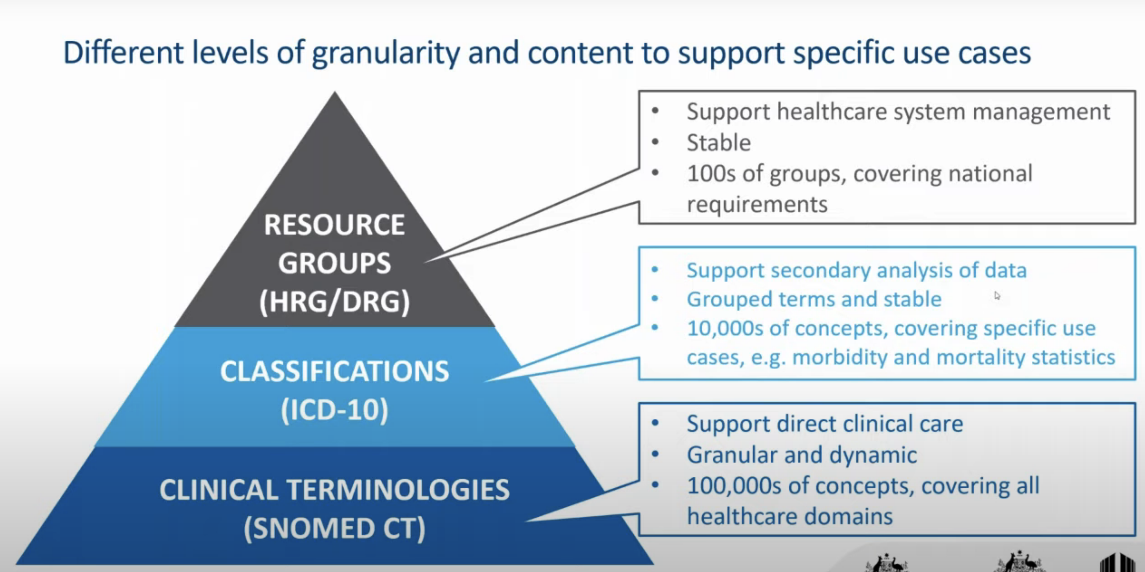
https://www.snomed.org/snomed-ct/five-step-briefing
SNOMED CT (Systematized Nomenclature of Medicine -- Clinical Terms)

Slide 51
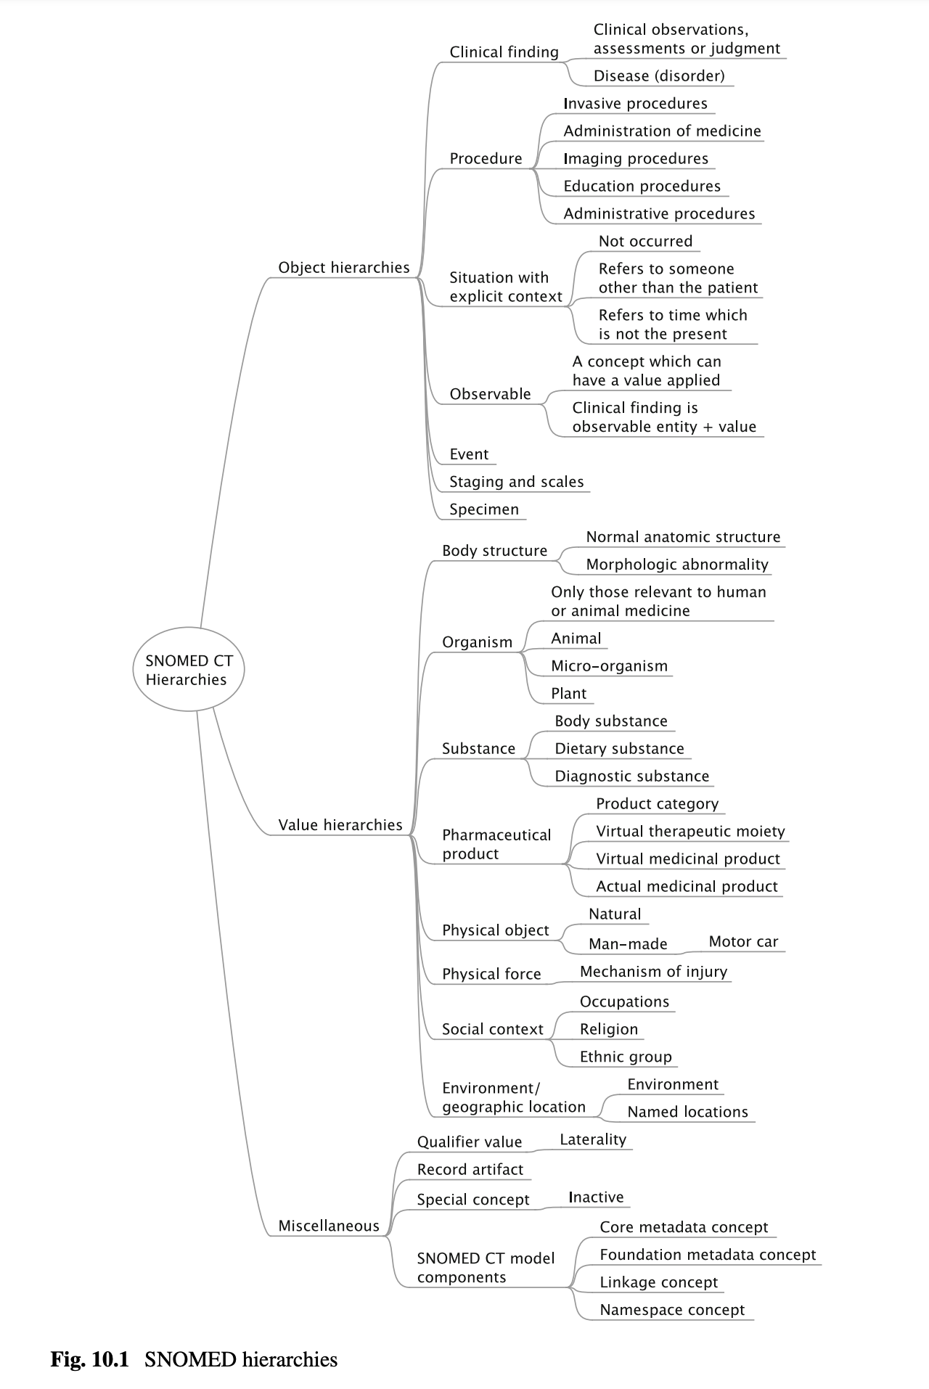

Slide 52
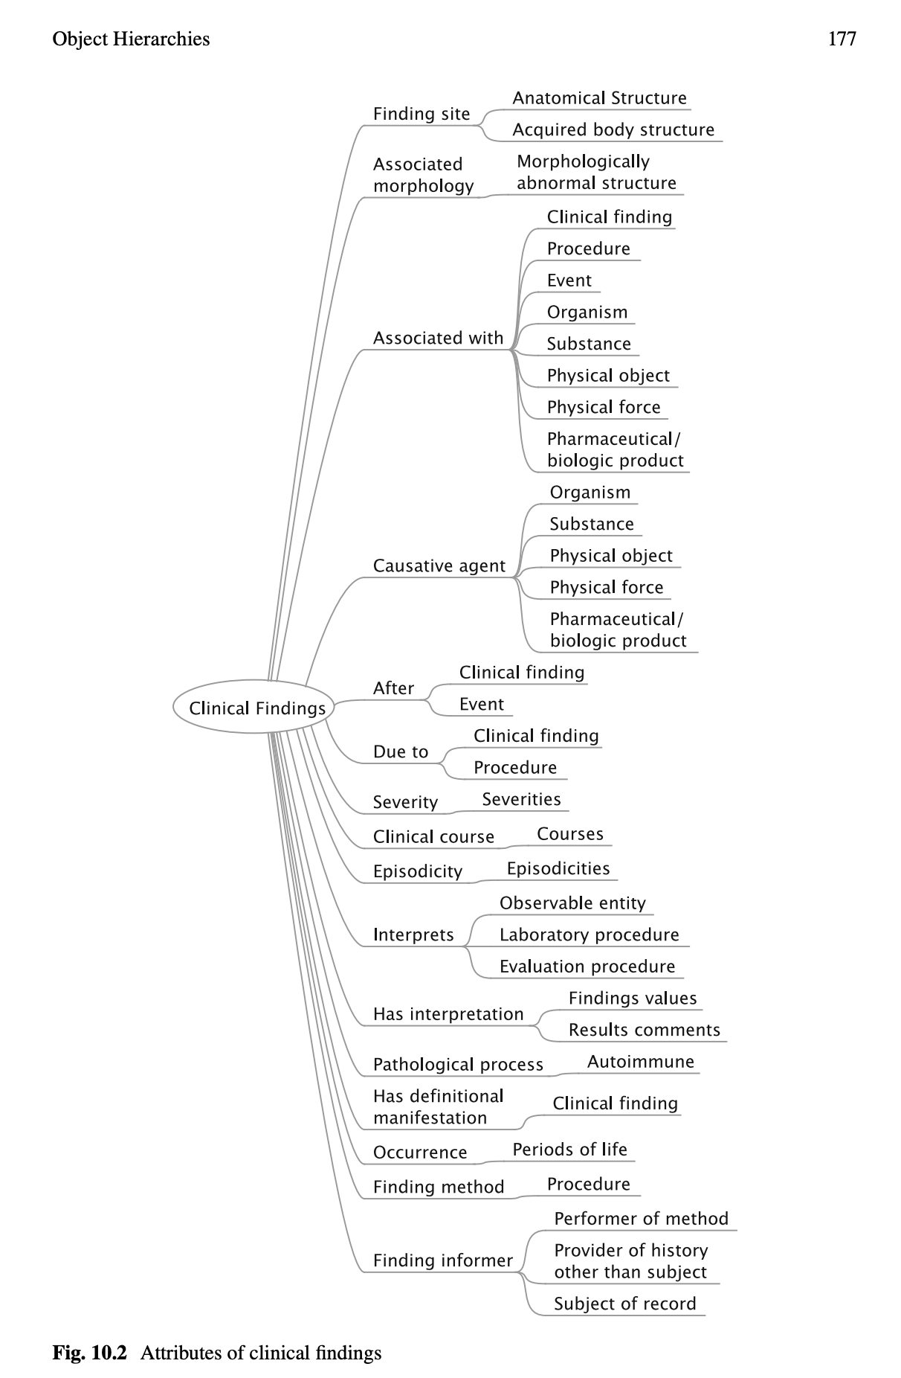
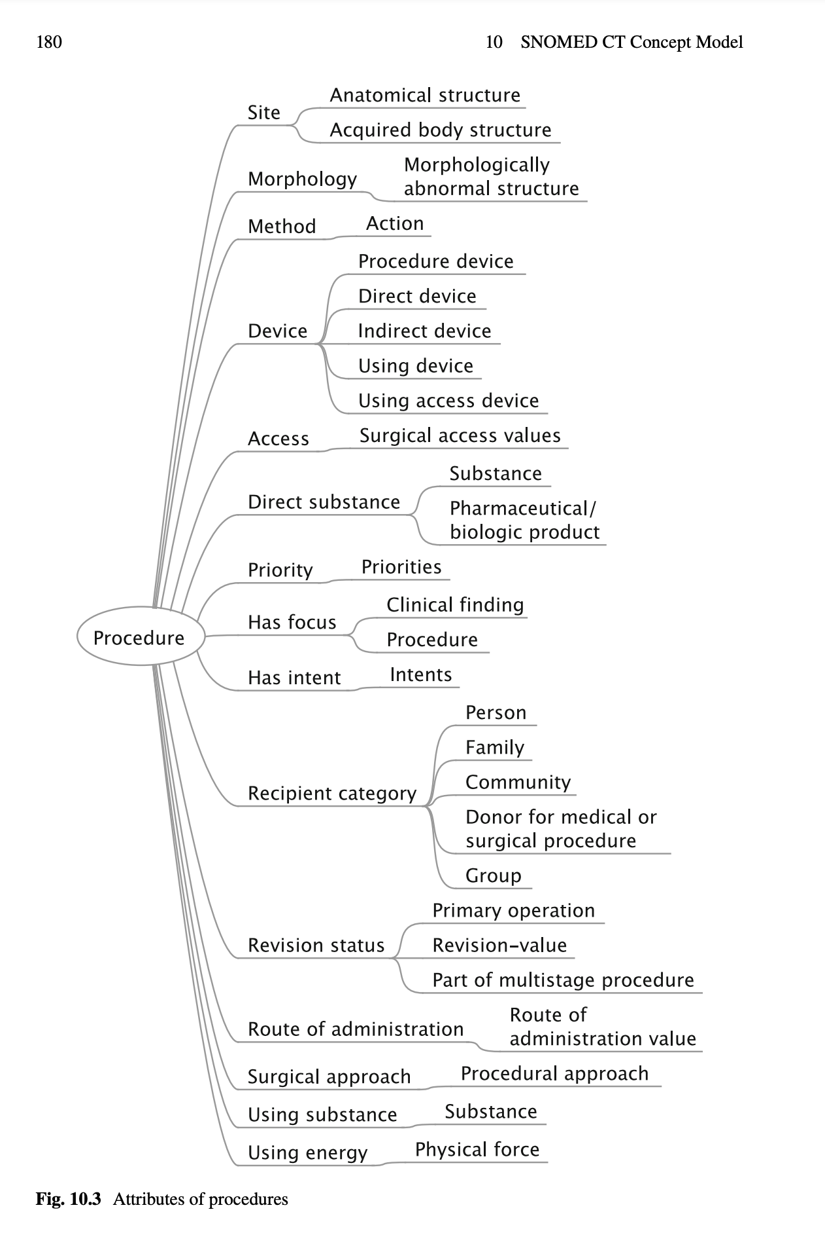

Slide 53
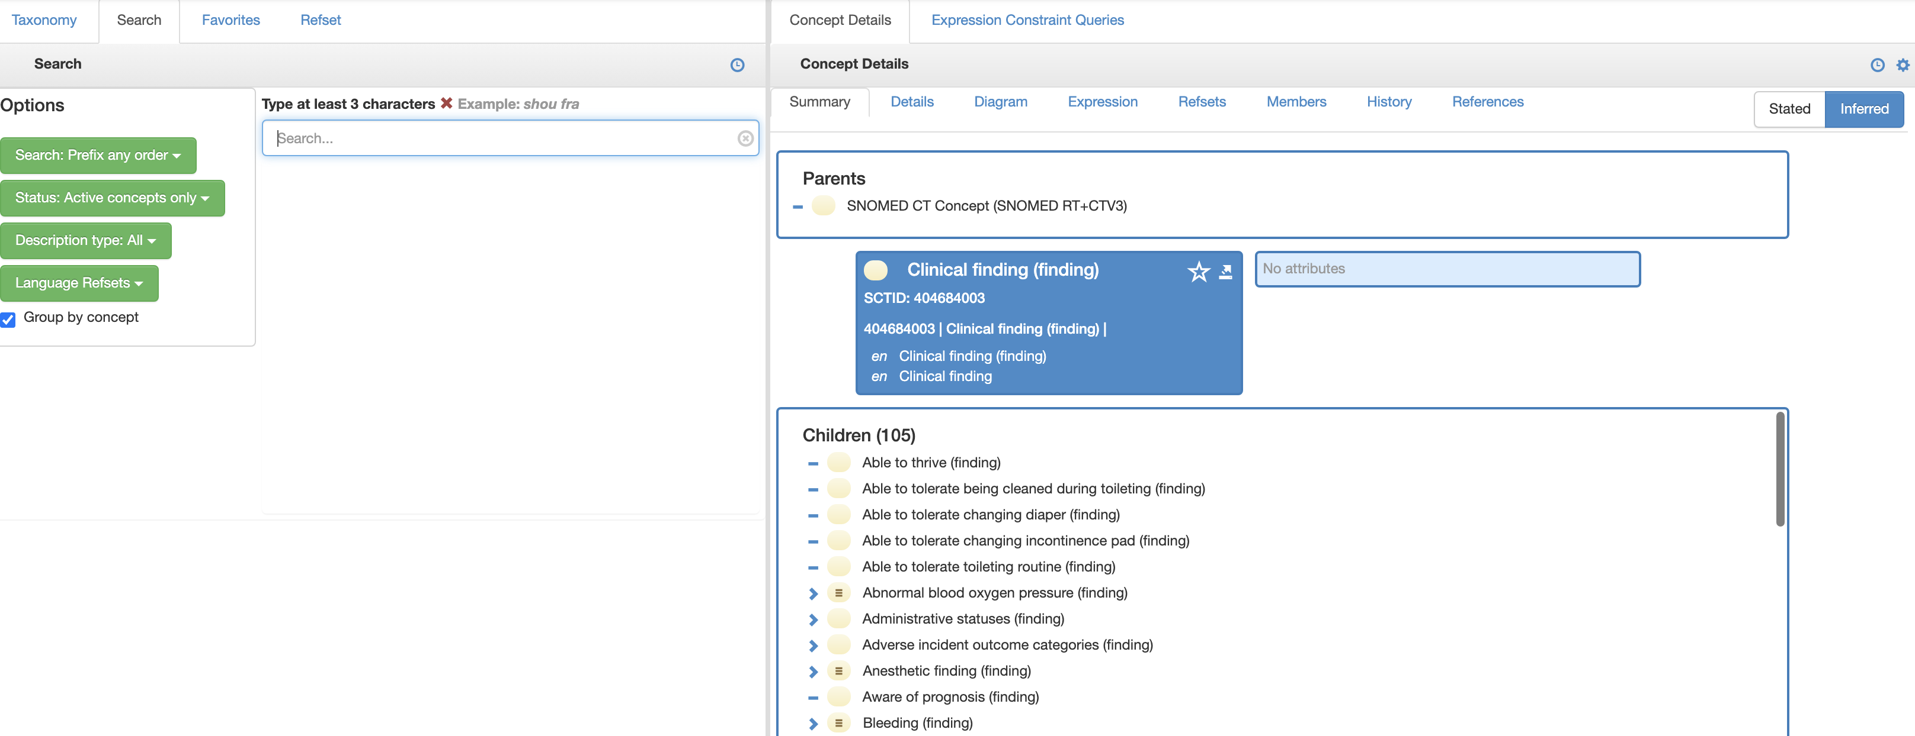
Unified Medical Language System® (UMLS®)
https://www.nlm.nih.gov/research/umls/index.html
https://browser.ihtsdotools.org/
https://uts.nlm.nih.gov/uts/umls/home
UK edition: https://snomedbrowser.com/

Slide 54
Claims Flow: CMS related

Slide 55
MDC
Major Diagnostic Category (1-25)
major complication or comorbidity (MCC) OR complication/comorbidity: Yes/No
MCC/CC
DRG
APR-DRG
CMS-DRG
MS-DRG

Slide 56
DRGs: Diagnosis-related groups [US]
HRGs: Healthcare-resource groups [NHS]

Slide 57
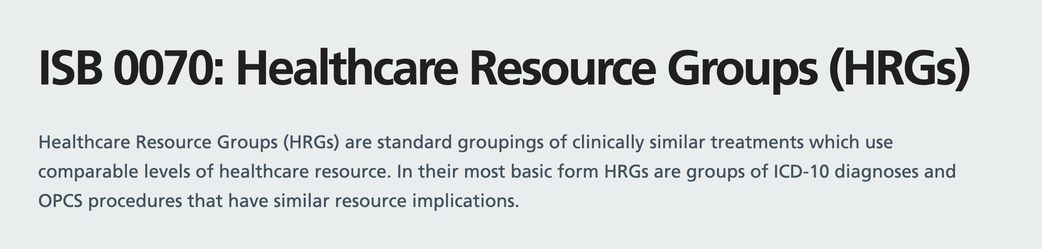
HRGs
Owned/managed by the NHS
https://data.standards.nhs.uk/published-standards/healthcare-resource-groups
The objective of using HRGs is to ensure that NHS organisations use a common standard to report activity.
HRGs are currently used as a means of determining fair and equitable reimbursement for care services delivered by providers
HRGs offer organisations the ability to understand their own activity in terms of the types of patients they care for, and the treatments they undertake. In addition they allow external comparative and benchmarking activity to take place.

Slide 58
DRGs: Diagnosis-related groups
Today there is no universal DRG system.
Each organization – healthcare service provider or insurance company – can create its own DRGs.
The most prominent being known as MS-DRG (medicare DRG).
Medicare Severity Diagnosis Related Groups
The MS-DRG classification and coding system starts by first dividing all the possible ailments a person could be suffering from into 25 different categories (called Medical Diagnostic Categories or MDCs) which are mostly based on different systems in the body (i.e., pertaining to the heart, lymph system, etc). A subset of codes within these initial 25 then identifies if the medical procedure is surgical or not.

Slide 59
MS-DRG
Medicare Severity Diagnosis Related Groups
The MS-DRG classification and coding system starts by first dividing all the possible ailments a person could be suffering from into 25 different categories (called Medical Diagnostic Categories or MDCs) which are mostly based on different systems in the body (i.e., pertaining to the heart, lymph system, etc).
A subset of codes within these initial 25 then identifies if the medical procedure is surgical or not.

Slide 60
Diagnosis Related Group {DRG}
Medicare Severity DRG (CMS-DRG & MS-DRG)
https://www.cms.gov/Medicare/Medicare-Fee-for-Service-Payment/AcuteInpatientPPS/MS-DRG-Classifications-and-Software
All Patient Refined DRGs (APR-DRG)
https://www.hcup-us.ahrq.gov/db/nation/nis/APR-DRGsV20MethodologyOverviewandBibliography.pdf
https://www.bcbst.com/providers/webinar/APRDRG.pdf
All Patient Severity adjusted DRG (APS-DRG)
https://www.hcup-us.ahrq.gov/db/nation/nis/APS-DRGsV20DefinitionsManual.pdf

Slide 61
DRGs
Interesting example dataset:
https://data.cms.gov/provider-summary-by-type-of-service/medicare-inpatient-hospitals/medicare-inpatient-hospitals-by-provider-and-service
Current DRGs:
https://www.cms.gov/Medicare/Medicare-Fee-for-Service-Payment/AcuteInpatientPPS/MS-DRG-Classifications-and-Software

Slide 62
MDS: Major Diagnostic Categories

Slide 63
MDC / Major Diagnostic Category
MS links with MDC

Slide 64
MDC / Major Diagnostic Category
Major Diagnostic Category (MDC) Code
T-MSIS Analytic Files (TAF) Claims Research Identifiable Files (RIFs), CCW Codebook, V1, November 2019
000 = Ungroupable
001 = Nervous System
002 = Eye
003 = Ear, Nose, Mouth, And Throat
004 = Respiratory System
005 = Circulatory System
006 = Digestive System
007 = Hepatobiliary System and Pancreas
008 = Musculoskeletal System and Connective Tissue
009 = Skin, Subcutaneous Tissue, and Breast
010 = Endocrine, Nutritional, and Metabolic System
011 = Kidney and Urinary Tract
012 = Male Reproductive System
013 = Female Reproductive System
014 = Pregnancy, Childbirth, and Puerperium
015 = Newborn and Other Neonates (Perinatal Period)
016 = Blood and Blood Forming Organs and Immunological Disorders
017 = Myeloproliferative Diseases and Disorders (Poorly Differentiated Neoplasms)
018 = Infectious and Parasitic Diseases and Disorders
019 = Mental Diseases and Disorders
020 = Alcohol/Drug Use or Induced Mental Disorders
021 = Injuries, Poison, and Toxic Effect of Drugs
022 = Burns
023 = Factors Influencing Health Status
024 = Multiple Significant Trauma
025 = Human Immunodeficiency Virus (HIV) Infection
Null/missing = source value is missing or unknown
https://resdac.org/cms-data/variables/major-diagnostic-category-mdc-code
https://resdac.org/sites/datadocumentation.resdac.org/files/Major%20Diagnostic%20Category.txt

Slide 65
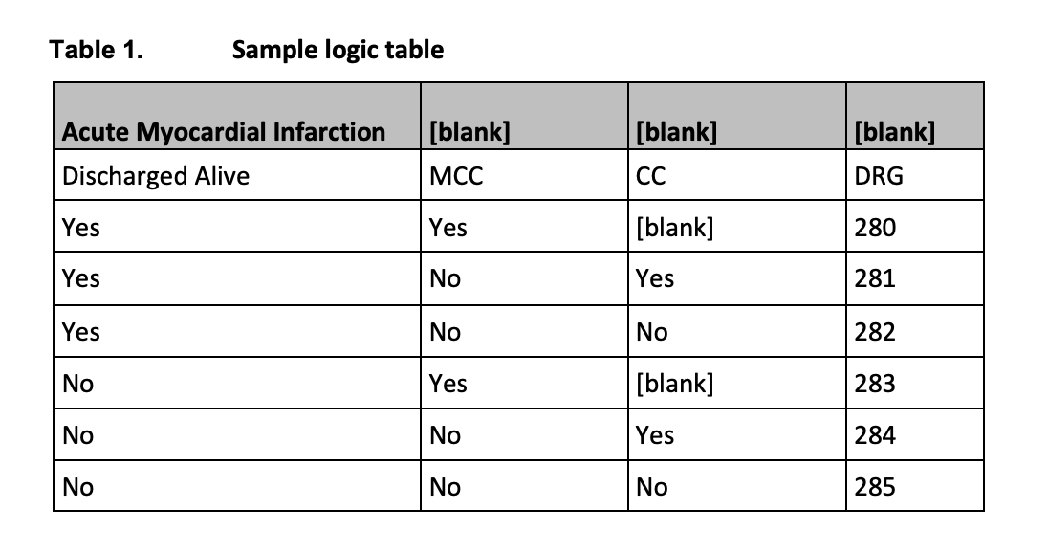
MS-DRG Related MCC, CC
https://www.cms.gov/icd10m/version37-fullcode-cms/fullcode_cms/Defining_the_Medicare_Severity_Diagnosis_Related_Groups_(MS-DRGs).pdf
ACUITY OF THE CODE
major complication or comorbidity (MCC)
complication or comorbidity (CC)

Slide 66
MS-DRG
CC and MCC
https://www.cms.gov/icd10m/version37-fullcode-cms/fullcode_cms/P0031.html
https://www.cms.gov/icd10m/version36-fullcode-cms/fullcode_cms/P0031.html
https://www.cms.gov/icd10m/version35-fullcode-cms/fullcode_cms/P0031.html
codes that are defined as either a complication or comorbidity (CC) or a major complication or comorbidity (MCC)
https://www.cms.gov/icd10m/version37-fullcode-cms/fullcode_cms/P0373.html

Slide 67
MDC
DRG
RW: Relative Weight
The average relative weight is 1.0. DRGs with a relative weight of less than 1.0 are less resource-intensive to treat and are generally less costly to treat. DRG’s with a relative weight of more than 1.0 generally require more resources to treat and are more expensive to treat. The higher the relative weight, the more resources are required to treat a patient with that DRG.
Each year CMS assigns a relative weight to each DRG. These weights indicate the relative costs for treating patients during the prior year.
The national average charge for each DRG is compared to the overall average. This ratio is published annually in the Federal Register for each DRG.
A DRG with a weight of 2.0000 means that charges were historically twice the average; a DRG with a weight of 0.5000 was half the average.
MCC/CC
https://www.cms.gov/files/document/frequently-asked-questions-faqs-market-based-ms-drg-relative-weight-data-collection-and-change.pdf

Slide 68
MDC
Major Diagnostic Category (1-25)
major complication or comorbidity (MCC) OR complication/comorbidity: Yes/No
MCC/CC
APR-DRG
CMS-DRG
MS-DRG
DRG

Slide 69
Pharm Codes
NDC versus RxNorm

Slide 70
NDC
National Drug Code (NDC) which serves as the FDA’s identifier for drugs. FDA publishes the listed NDC numbers in the NDC Directory which is updated daily.
The NDC Directory contains information on active and certified finished and unfinished drugs submitted to FDA in structured product labeling (SPL) electronic listing files by labelers. A labeler may be a manufacturer, including a repackager or relabeler, or the entity named on the product label.

Slide 71
10-digit NDC
The CMS NDC identifier is formatted as 11 digits with no spaces, hyphens or other characters.
https://www.accessdata.fda.gov/scripts/cder/ndc/index.cfm

Slide 72
RXNorm
RxNorm is two things: a normalized naming system for generic and branded drugs; and a tool for supporting semantic interoperation between drug terminologies and pharmacy knowledge base systems. The National Library of Medicine (NLM) produces RxNorm.
Purpose of RxNorm
Hospitals, pharmacies, and other organizations use computer systems to record and process drug information. Because these systems use many different sets of drug names, it can be difficult for one system to communicate with another. To address this challenge, RxNorm provides normalized names and unique identifiers for medicines and drugs. The goal of RxNorm is to allow computer systems to communicate drug-related information efficiently and unambiguously.
Scope of RxNorm
RxNorm contains the names of prescription and many over-the-counter drugs available in the United States.
RxNorm includes generic and branded:
Clinical drugs - pharmaceutical products given to (or taken by) a patient with therapeutic intent
Drug packs - packs that contain multiple drugs, or drugs designed to be administered in a specified sequence
Non-therapeutic radiopharmaceuticals, bulk powders, contrast media, food, dietary supplements, and medical devices are all out-of-scope for RxNorm. Medical devices include but are not limited to bandages and crutches.

Slide 73
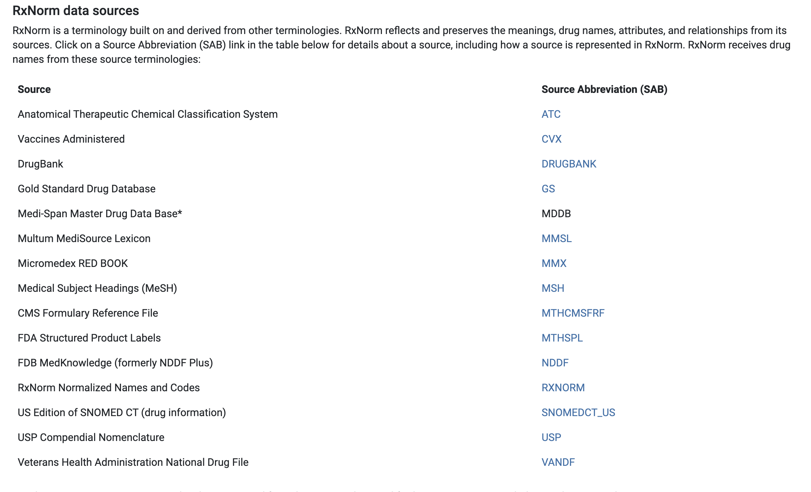
https://www.nlm.nih.gov/research/umls/rxnorm/overview.html

Slide 74
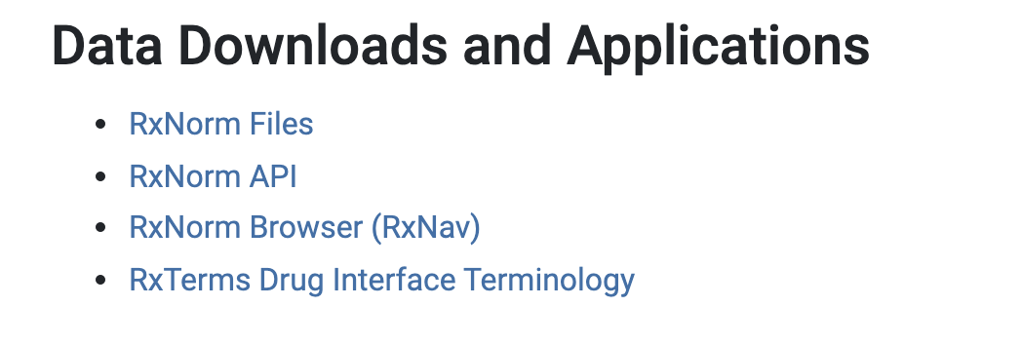
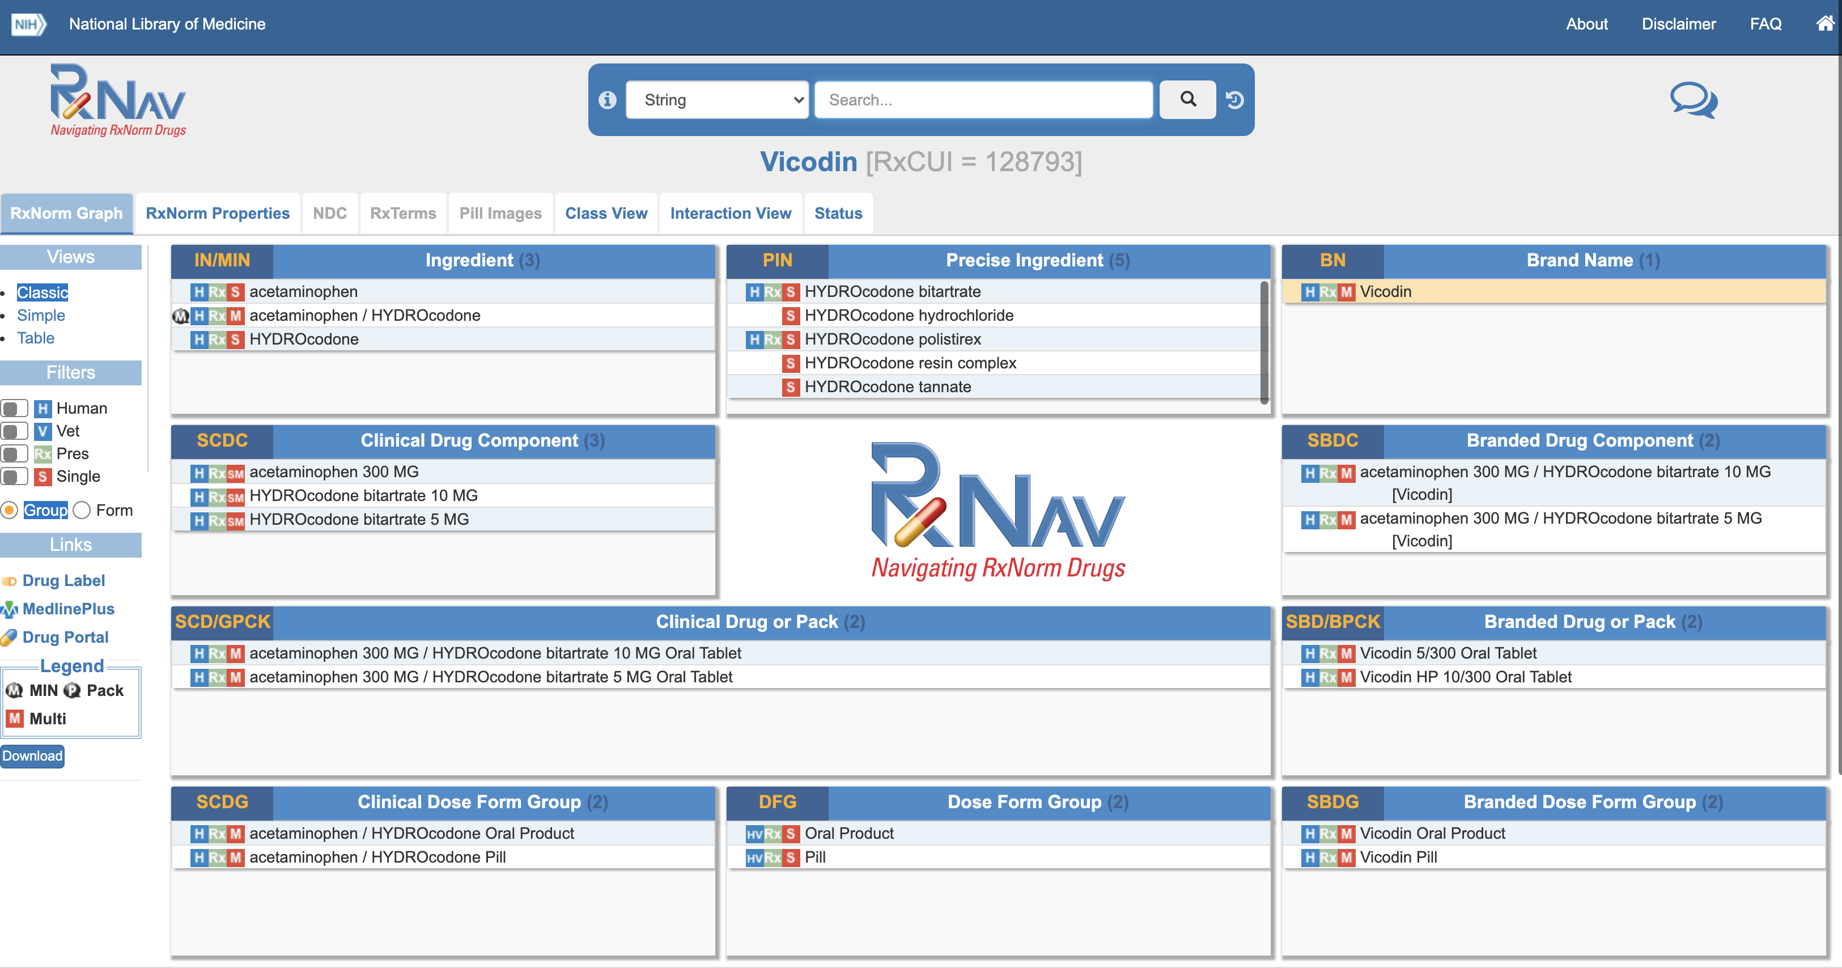
https://www.nlm.nih.gov/research/umls/rxnorm/index.html
https://mor.nlm.nih.gov/RxNav/

Slide 75
LOINC codes
https://www.regenstrief.org/
LOINC is a common language (set of identifiers, names, and codes) for identifying health measurements, observations, and documents
https://loinc.org/panels/
https://loinc.org/sdh/
https://loinc.org/newborn-screening/
https://loinc.org/document-ontology/
https://loinc.org/attachments/

Slide 76
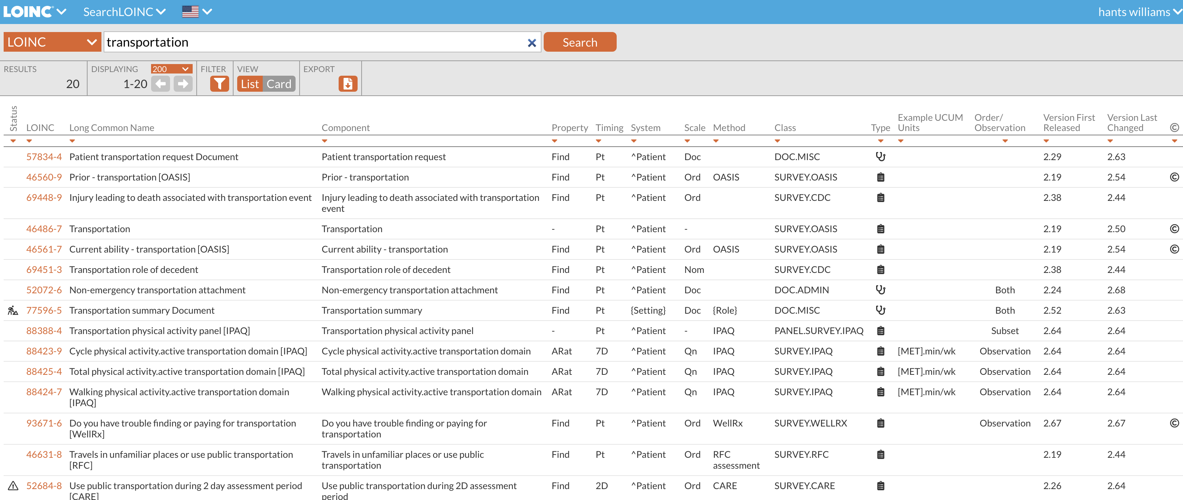
https://loinc.org/search/?t=1&s=transportation

Slide 77
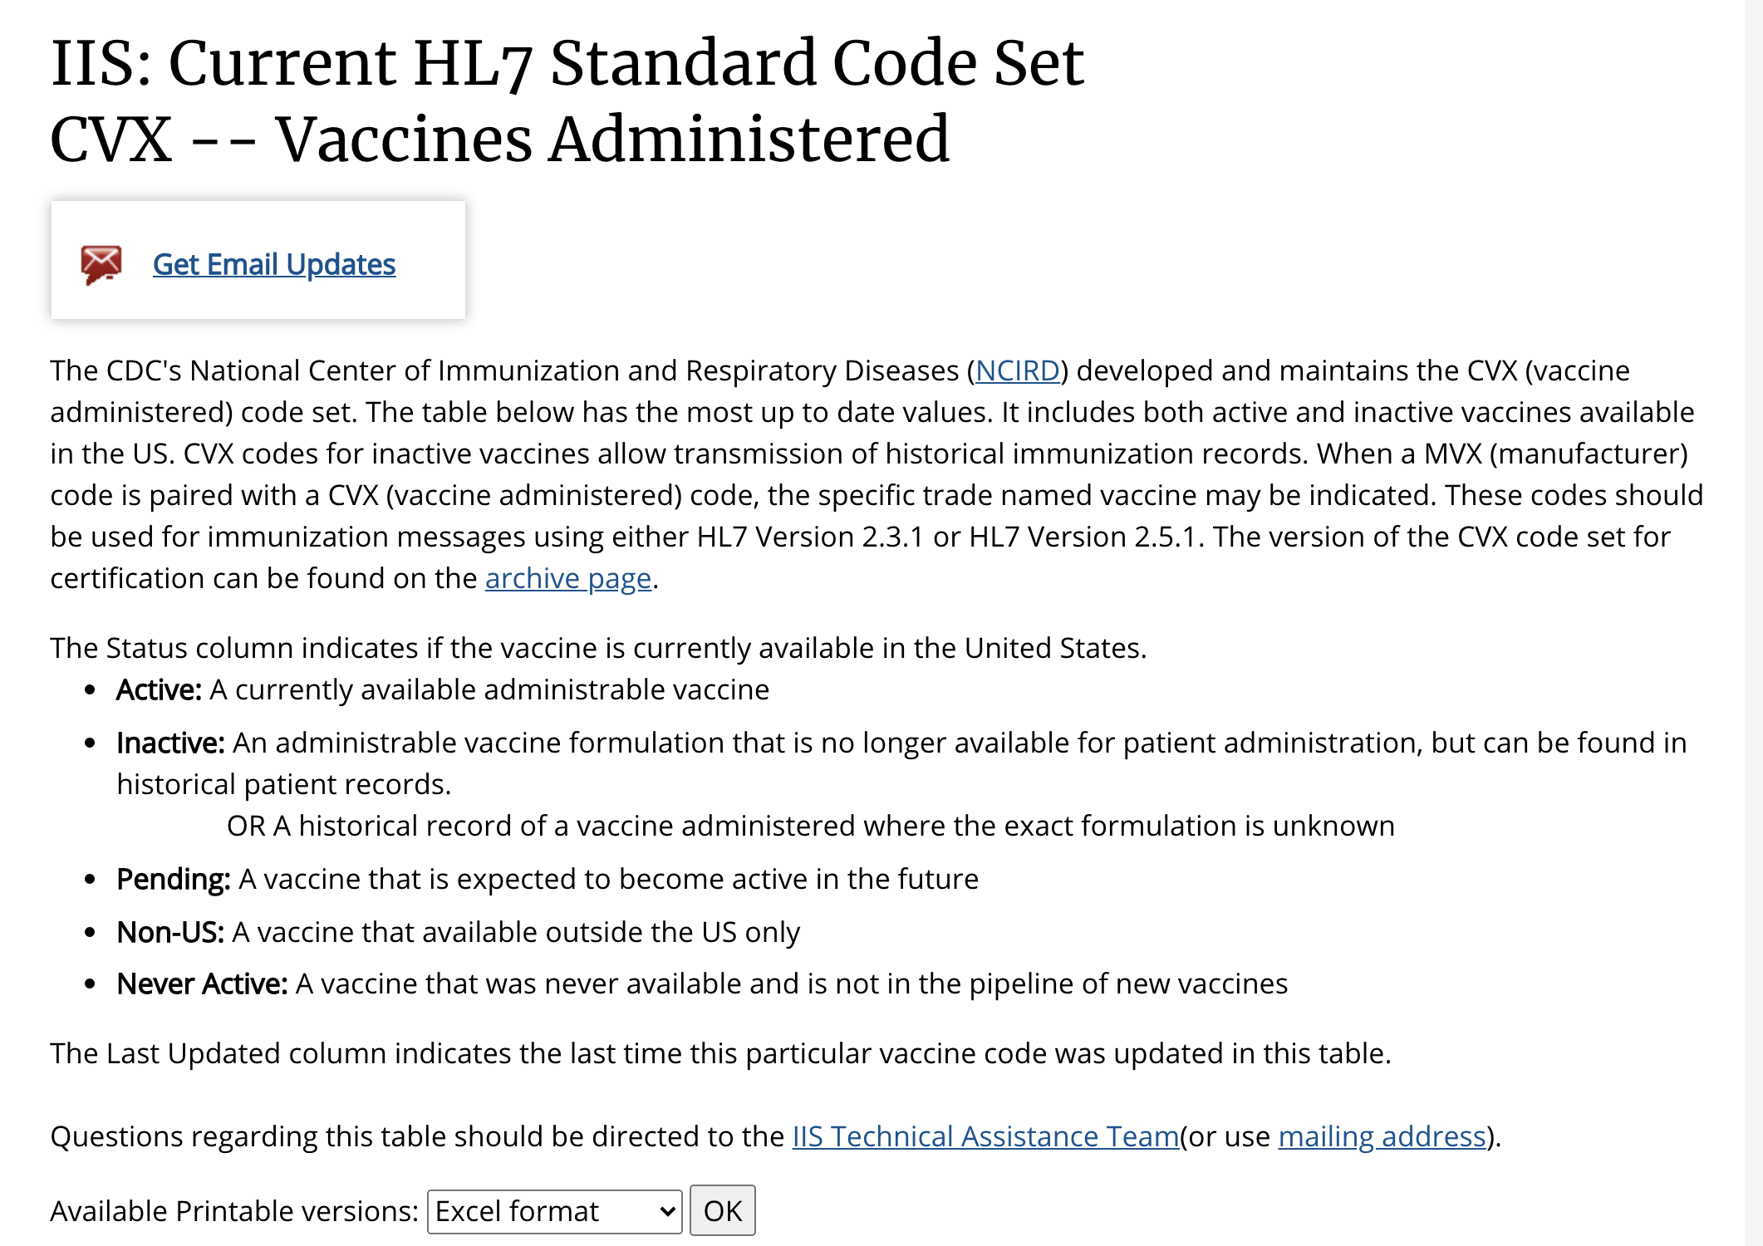
CVX
https://www2a.cdc.gov/vaccines/iis/iisstandards/vaccines.asp?rpt=cvx

Slide 78
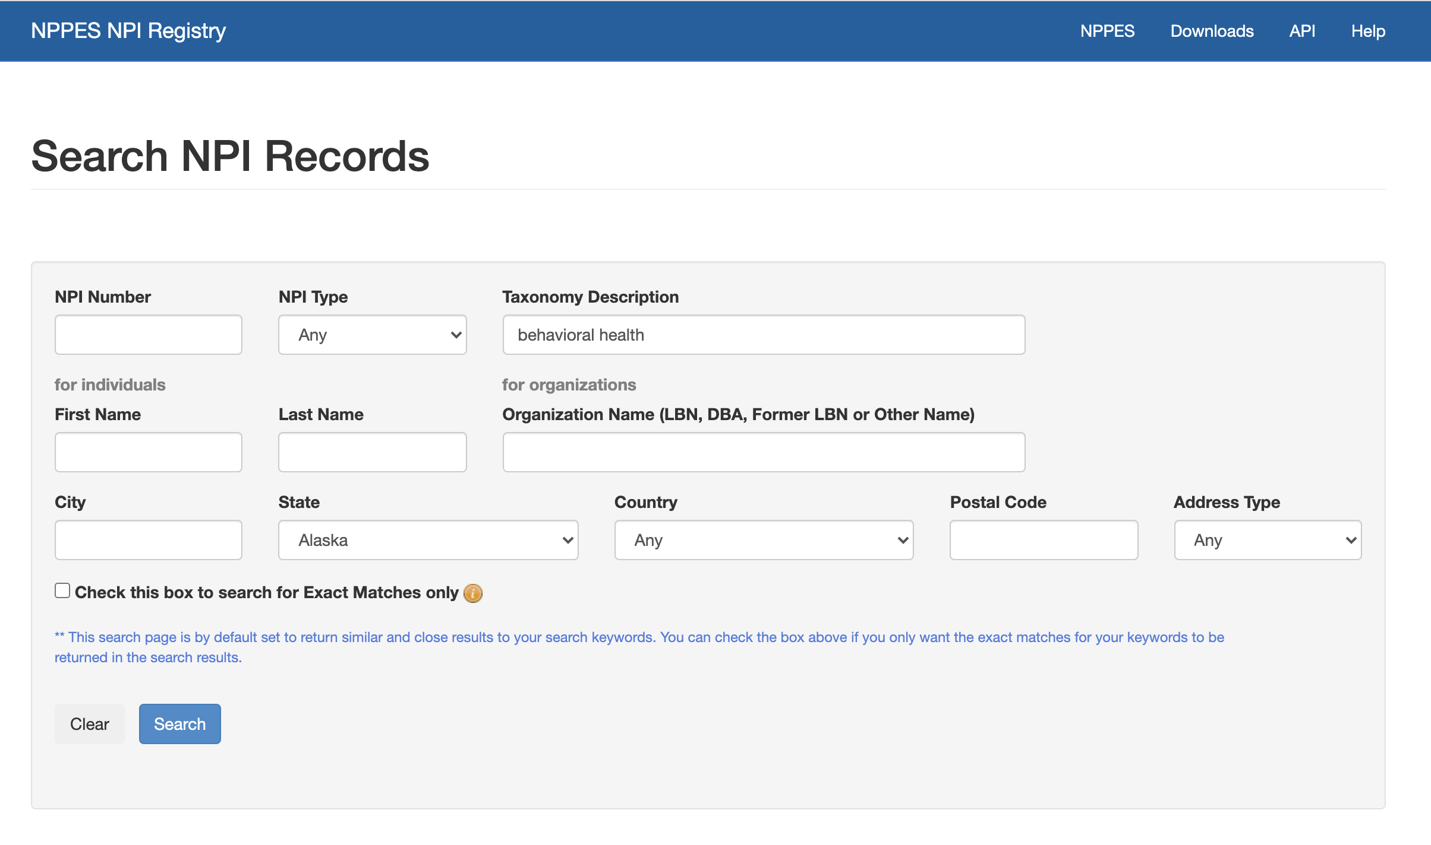
NPI
National provider index
https://npiregistry.cms.hhs.gov/
https://taxonomy.nucc.org/

Slide 79
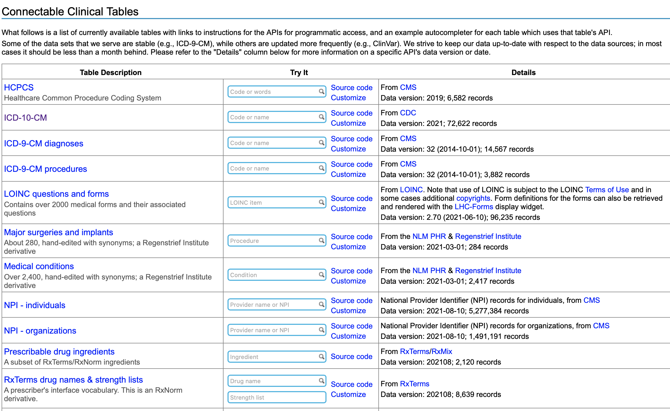
https://clinicaltables.nlm.nih.gov

Slide 80
PUF {public use files}
Health Insurance
https://www.cms.gov/CCIIO/Resources/Data-Resources/marketplace-puf

Slide 81
Example:
1. https://www.cms.gov/CCIIO/Resources/Data-Resources/marketplace-puf
2. Machine-readable URL PUF (MR-PUF)—Issuer-level URL locations for machine-readable network provider and formulary information.

Slide 82

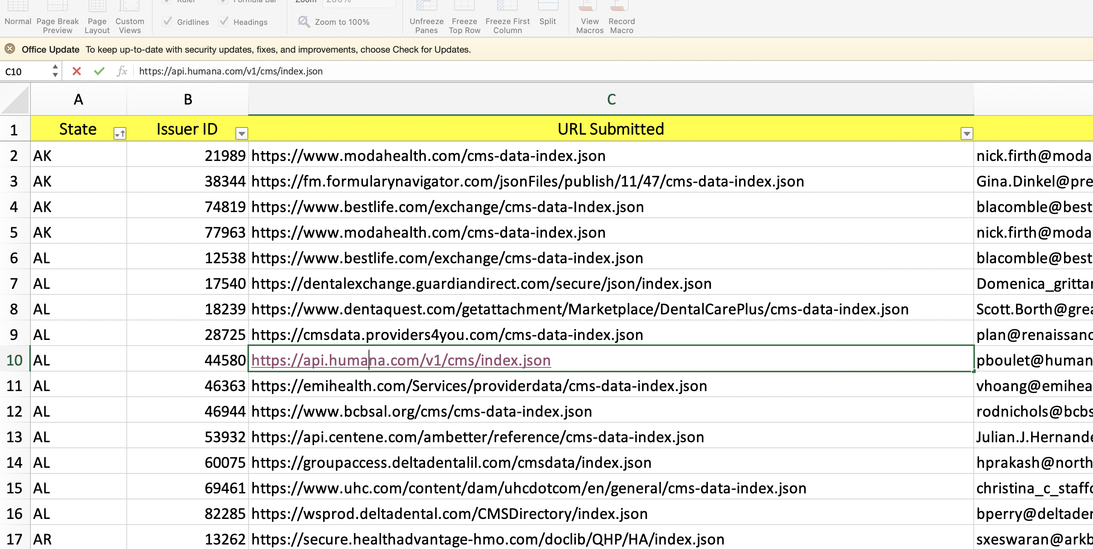
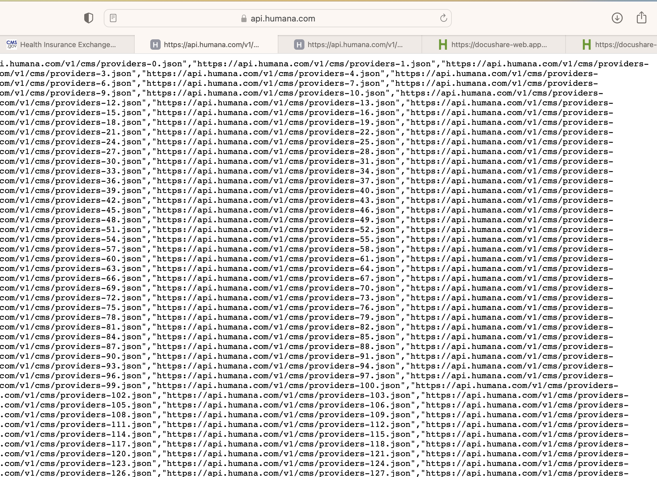

Slide 83
Claims
https://www.ahrq.gov/data/apcd/index.html
https://www.commonwealthfund.org/publications/fund-reports/2020/dec/state-apcds-part-1-establish-make-functional
https://www.health.state.mn.us/data/apcd/publicusefiles/download.html

Slide 84
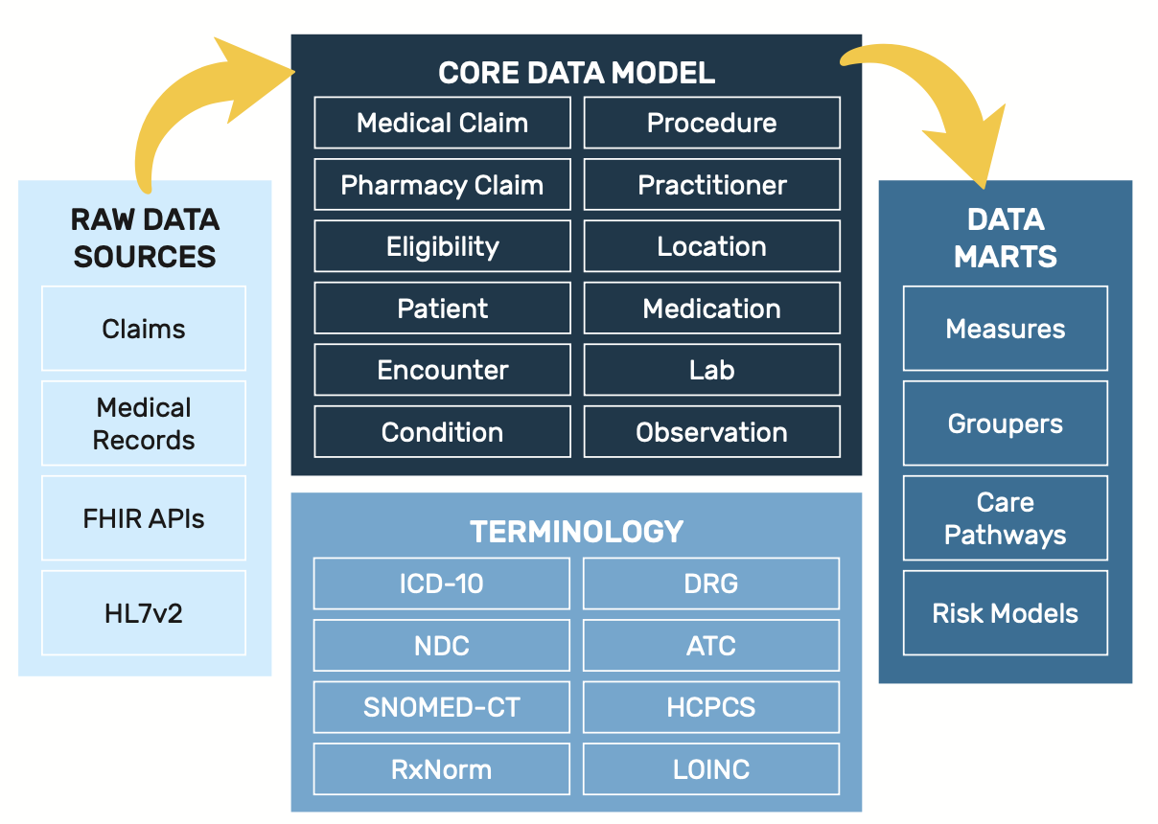
Putting it all together into a solution
Population Health / Care Management related solutions…
Quality Measures:
Breast Cancer Screening
Colorectal Cancer Screening
Controlling high blood pressure
Diabetes: Eye exam
Falls: Screening for future fall risk
https://thetuvaproject.com/
https://thetuvaproject.com/quality-measures

Slide 85
Homework
Find a dataset that contains a medical codex (ICD, HCPCS, Snowmed, etc…). I recommend that you focus on healthdata.gov, cdc.gov, etc….something that relates to a governmental resource that is likely to contain one
You should be able to either download a .csv file of the dataset and manually upload that dataset into a notebook environment, or use a hyperlink or API to bring the data directory into a notebook from a URL
2. Create a script (google colab notebook, google shell (.py) that provides some summary information on it
Must use at least the following package: pandas
Use value_counts for categories; use .describe for continuous measures
3. For submission:
You must submit the URL of your notebook; if the notebook is not made public, or shared to my email – you wil lose ½ of the assignment

